Slide 1

Ethics of Accountability
in the Future of the Criminal Justice System
The use of Artificial Intelligence in
Pretrial Bail Determinations &
Assessment of Police Officer Misconduct
Final Report
Jennifer C. Johnson, JD
DATA 205
Professor Iapalucci

Slide 2

Part I. Have AI Algorithms used in Bail Determinations Reduced the Pretrial Detention Rates?
Part II. Have AI Algorithms and Risk Assessment Tools Reduced Bias in Pretrial Bail Amounts?
Part III. Can AI Algorithms improve accountability for Police Misconduct?

Slide 3
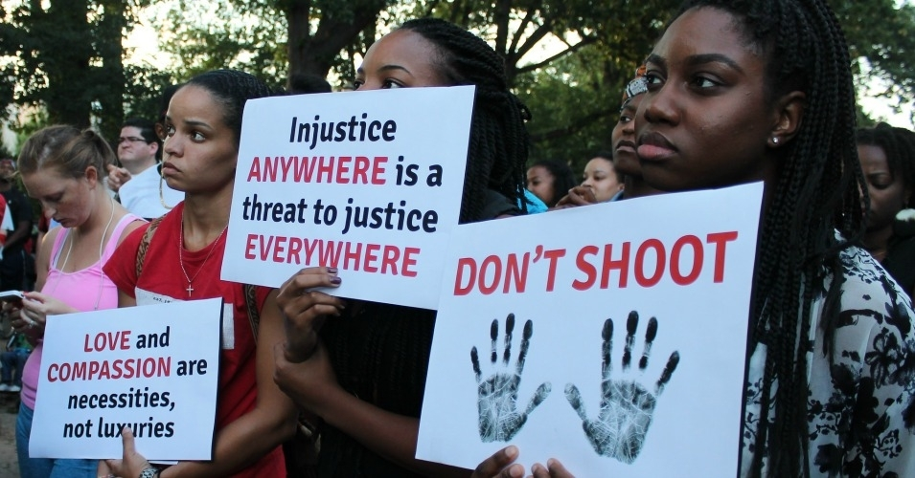

Why this Analysis is Important and Relevant
Current Intersection of:
National criminal justice reform movements
Ethical and regulatory hearings on the use of AI algorithms in society at large
… at the same time Algorithm use within the criminal justice system is increasing rapidly.
How do we use these tools ethically, conscientiously, and responsibly, and … do they work?
Notes:
Senate Bill 71 -- Maryland Police Accountability Act of 2021, which mandates body-worn cameras statewide and changes use-of-force guidelines.
Senate Bill 178 - Maryland Police Accountability Act of 2021 (Anton's Law), which changes how search warrants can be executed, limits the use of no-knock warrants and allows for the inspection of records relating to police conduct. Under the bill, police could only use no-knock warrants between 8 a.m. and 7 p.m., except in an emergency.
House Bill 670 - Police Reform and Accountability Act of 2021, which repeals the Law Enforcement Officers' Bill of Rights.

Slide 4
BACKGROUND INFORMATION

Slide 5
Overview of Criminal Law Procedural Timeline & Terms
Presumption of Innocence
Plea hearings can occur any time
EVENT
Arraignment: Initial Pleading , Judge
Receives AI risk assessment score, Bail Set
CPU Booking, First Bail Determination
Discovery, Pretrial Hearings
Sentencing for
convictions
Arrest
Trial or Plea
48 hrs., 72 hrs.
6 months – 18 months of pretrial detention is not uncommon
Immediately after arrest
Nationally, 74% of people in city & county jails are detained pretrial.
Only 26% have been convicted.
TIMELINE
https://www.prisonpolicy.org/research/pretrial_detention/

Slide 6
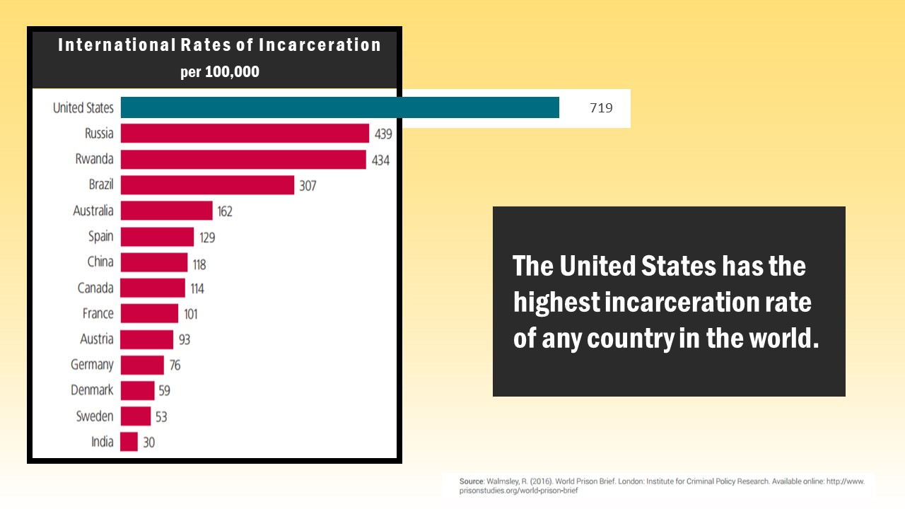
The United States has by far the highest incarceration rate of any country in the world
https://freedomprojectwa.org/slide2/

Slide 7
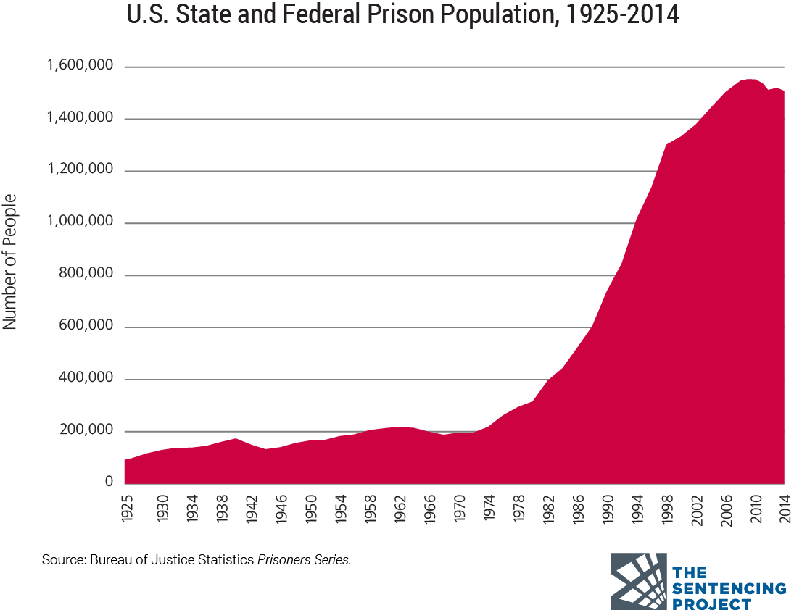
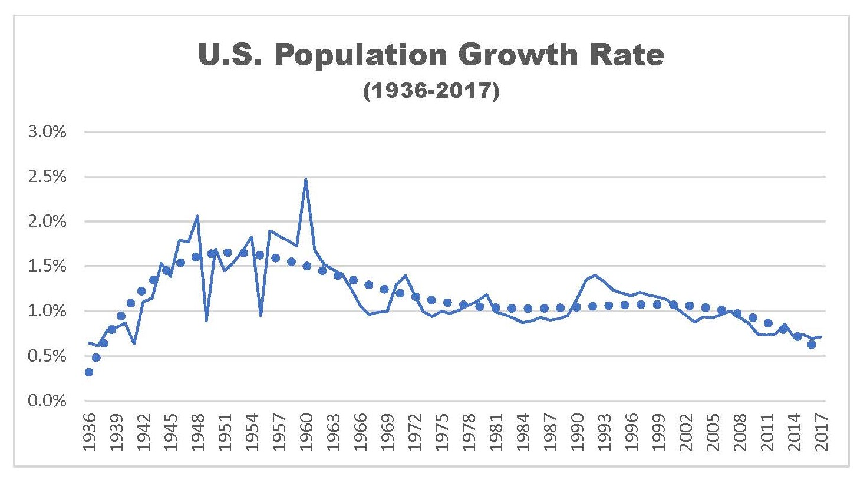
The U.S. Legislative “War on Drugs”
Initiated in the 1970s, expanded in the 1980s and propelled by the 1994 Crime Bill
500% increase in incarceration for mostly non-violent, drug possession offenses
Poor communities, communities of color, and people with mental health and addiction issues have been disproportionately negatively affected
Now, the prison system is the largest mental health institution in the US
Today, 70% of defendants are imprisoned pretrial
Source: Bureau of Justice Statistics Prisoners Series.
https://www.politifact.com/factchecks/2016/jul/10/cory-booker/how-war-drugs-affected-incarceration-rates/;
https://www.prisonpolicy.org/research/pretrial_detention/; https://dash.harvard.edu/bitstream/handle/1/32630655/5397789.pdf?sequence=1&isAllowed=y

Slide 8
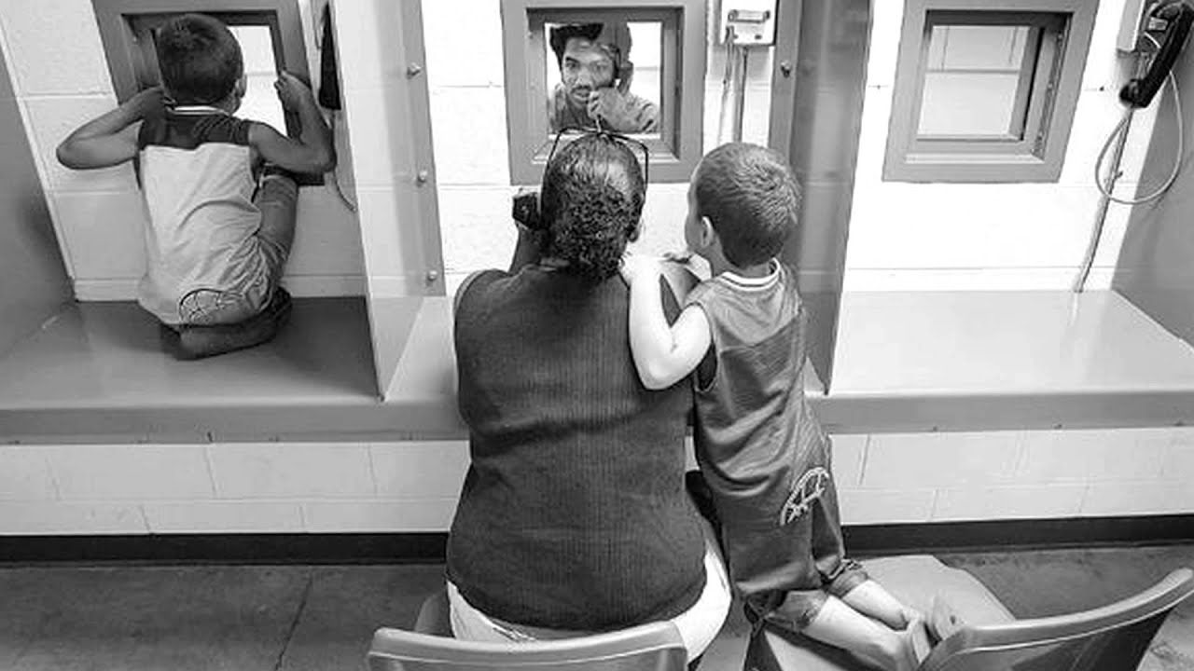


Presumption of Innocence
A fundamental principle of U.S. Criminal law is that defendants accused of a crime are presumed to be innocent until convicted.
Collateral Consequences of Imprisonment
1. Dobbie, W., Goldin, J. & Yang, C.S. (Feb. 2018). The Effects of Pretrial Detention on Conviction, Future Crime, and Employment: Evidence form Randomly Assigned Judges. American Economic Review, 180(2) pp. 201-40. https://www.aeaweb.org/articles?id=10.1257/aer.20161503

Slide 9
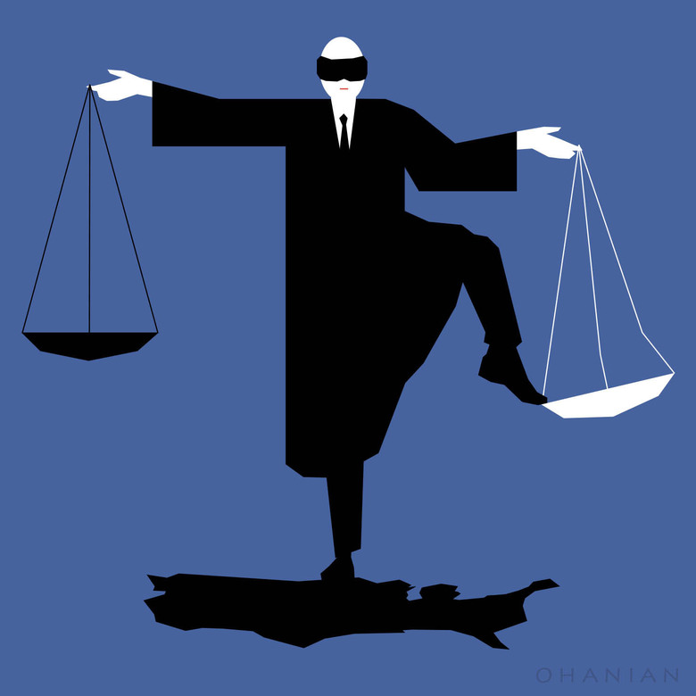
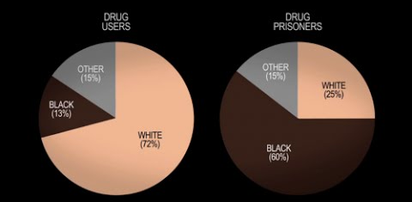
Arguments for the use of AI in Bail Determinations
Reduce the high number of people detained pretrial, placing more people in pre-trial probation or pre-trial services (Part I)
Decrease amount of bias in pretrial detention determinations (Part II)
http://www.usprisonculture.com/blog/2012/12/

Slide 10
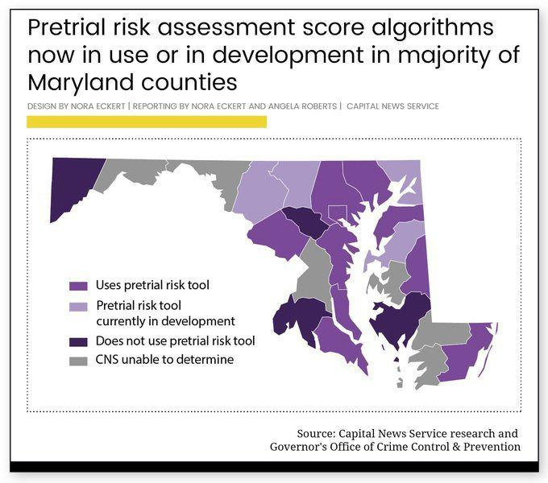
Context of this Topic In Maryland
AI is currently used in Maryland’s Criminal Justice System, including Montgomery County.
Over Half of MD counties use an algorithm to calculate “risk scores” for defendants that are then used by judges to make bail determinations.
MD Attorney General Initiatives
Reduce Prohibitive Bail Amounts
Increase transparency and accountability for Police Misconduct
April 9, 2021, MD 1st US State to pass legislation on improved accountability for Police Use of Force in the wake of George Floyd’s murder by officers in Minneapolis.
https://marylandreporter.com/2019/01/03/maryland-courts-begin-using-artificial-intelligence-in-bail-decisions/

Slide 11
Project Datasets
Part I. Impact of AI in Pre-trial Detention Rates
Correctional Facility Average Daily Population (2015-2020) – dataMontgomery
Crime Year to Date ( 2019 to Present) – dataMontgomery
Central Processing Unit (CPU) Processing/Booking of Arrestees(2016-Present) – dataMontgomery
Part II. Impact of Risk Assessments and AI on Bias in Pretrial Bail Amounts
Accused Pre-Trial Inmates in Correctional Facilities (2016-2021) – State of Connecticut Bail Data – CT Data.
Montgomery County has no equivalent dataset available
While CT does not use an Algorithm, they do utilize a “risk assessment tool” with similar variables
Part III. Police Internal Affairs Allegations – Should AI generate “Risk Scores” for Police Misconduct?
Internal Affairs Allegations (2013-2021) – dataMontgomery
Internal Affairs Discrimination Cases (2013-2021) – dataMontgomery
Access to Python Coding and Datasets available at: https://github.com/jcj217-mc/Data-_205_Final_Project

Slide 12
Part I. Pretrial Detention Rates

Slide 13
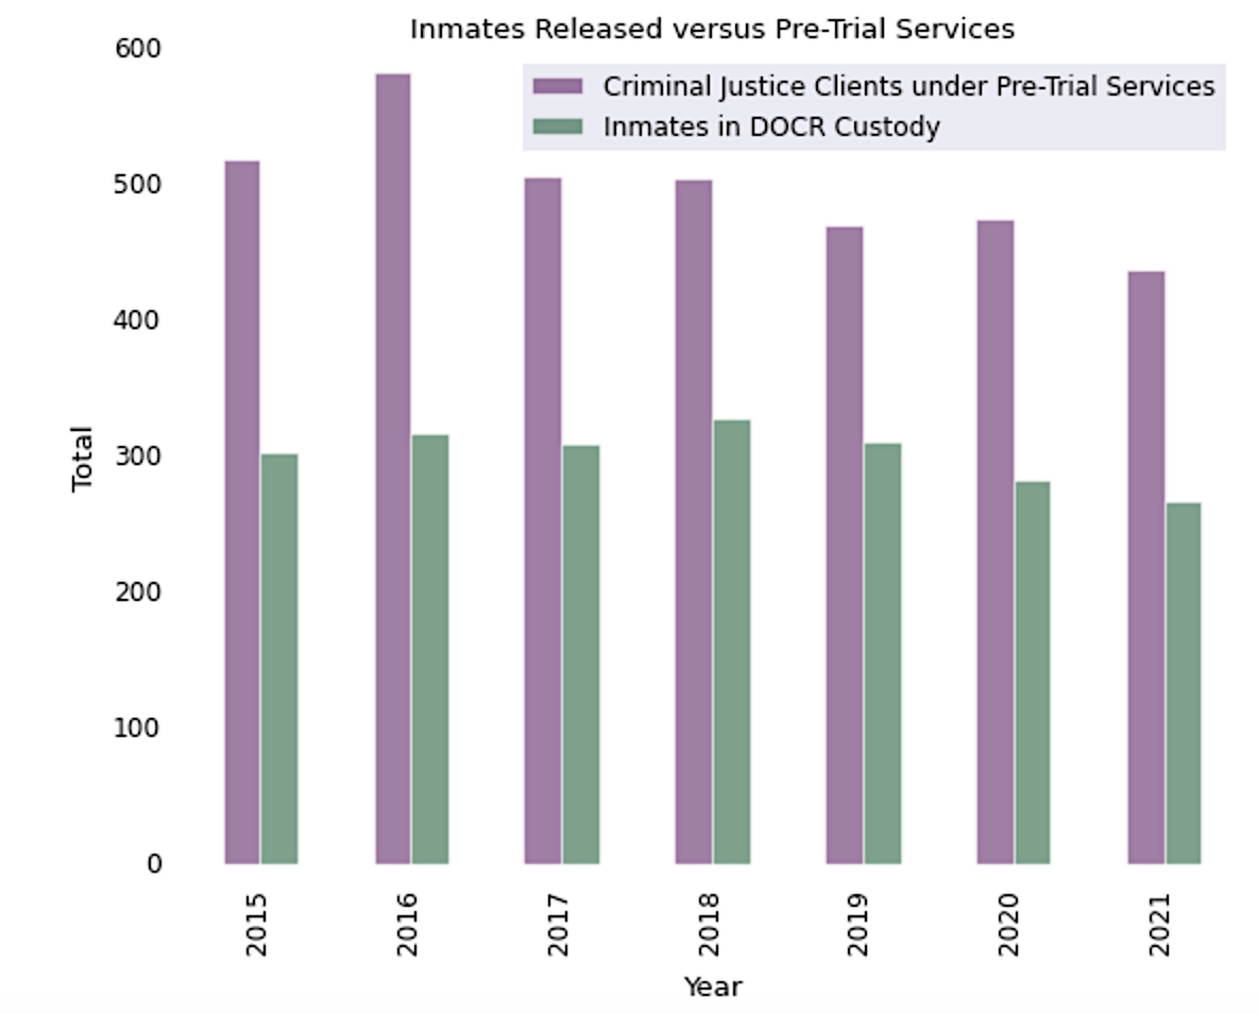
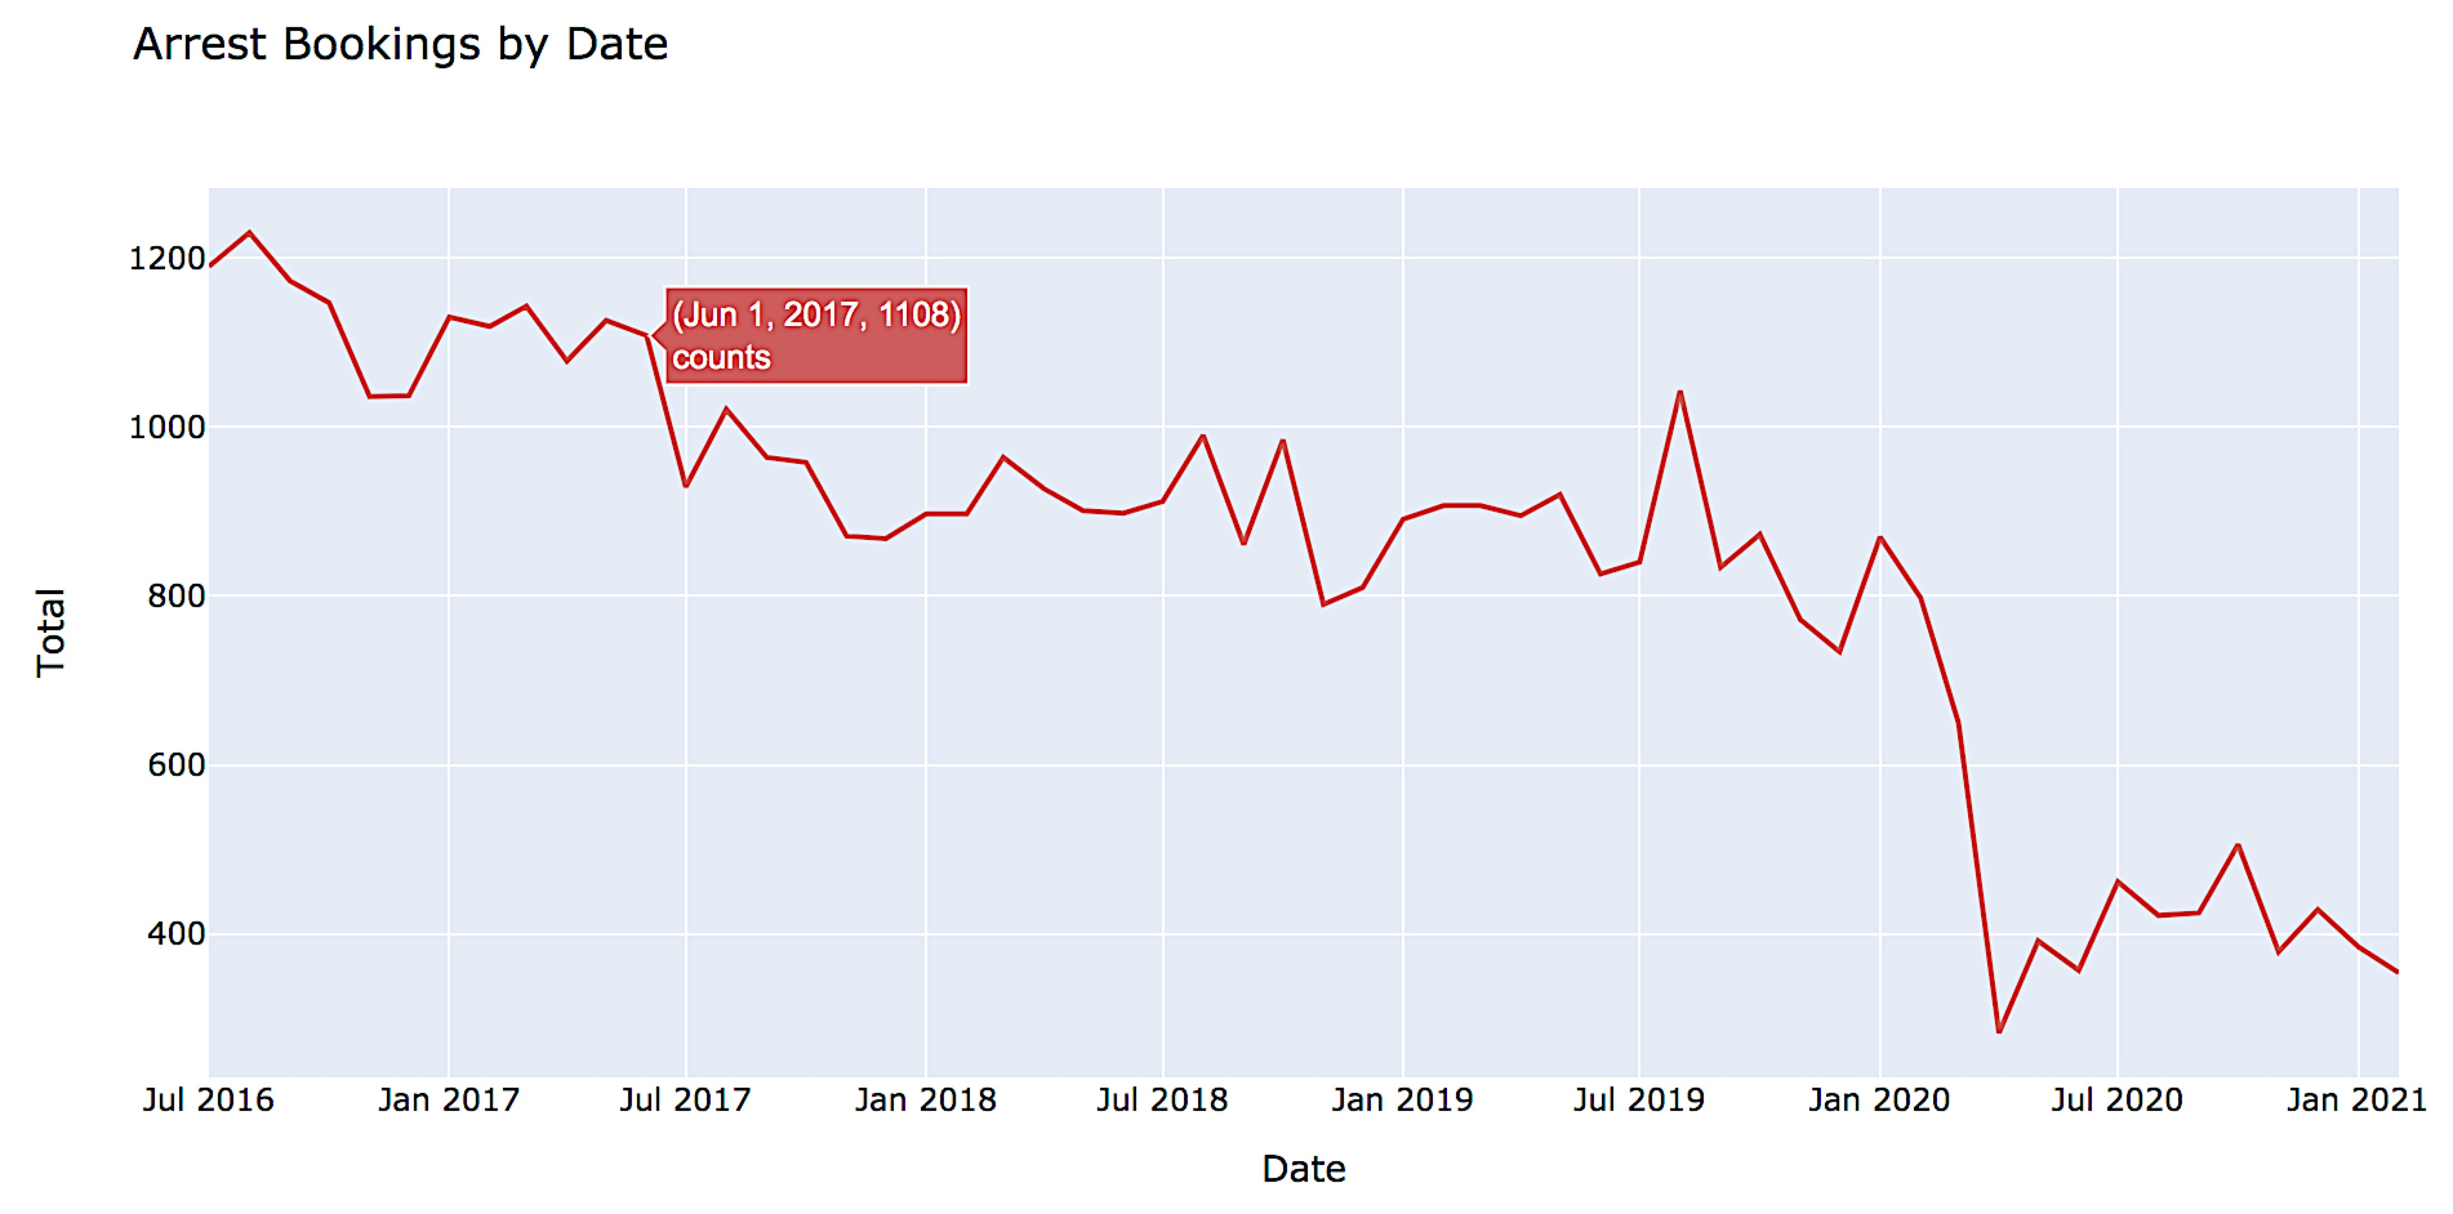
Pretrial Detention Datasets
Director of Montgomery County’s Department of Correction and Rehabilitation claimed a 30% decline in the pretrial detention population after implementing the bail algorithm.¹
However, the CPU Dataset shows that from 2016 to 2020 there was a 29.27% decrease in total arrests, which could account for the 30% decline the Director attributed to implementation of the algorithm.
1. https://marylandreporter.com/2019/01/03/maryland-courts-begin-using-artificial-intelligence-in-bail-decisions/

Slide 14
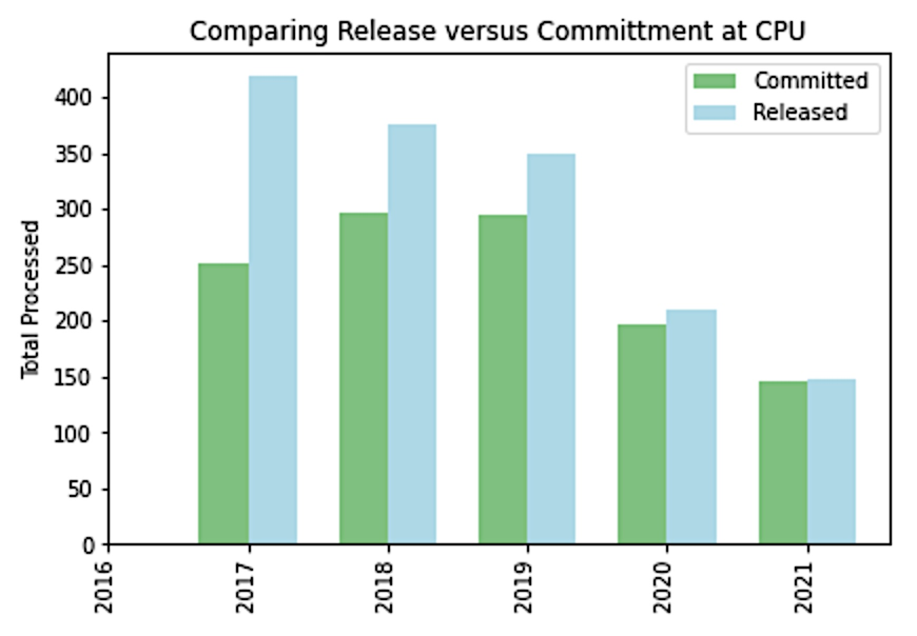
Pretrial Detention Datasets
The number of people processed at the CPU has decreased since 2019
But the chart suggests that the percentage rate of people arrested who are detained seems to have increased, rather than decreased.
Let’s examine the actual percentage rate changes…

Slide 15
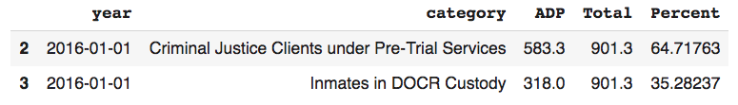
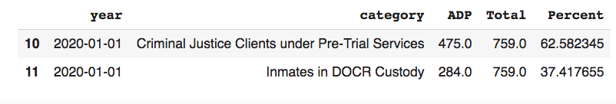
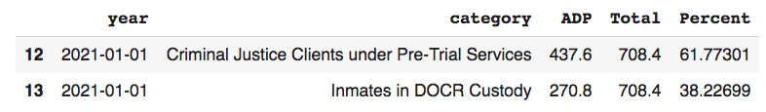
Pretrial Detention Datasets
The percentage rate has increased slightly for those detained in DOCR custody and
decreased slightly for pre-trial services each year
Correctional Facility Average Daily Population (2015-2020) dataset
That is opposite of what is expected with implementation of the algorithm.

Slide 16
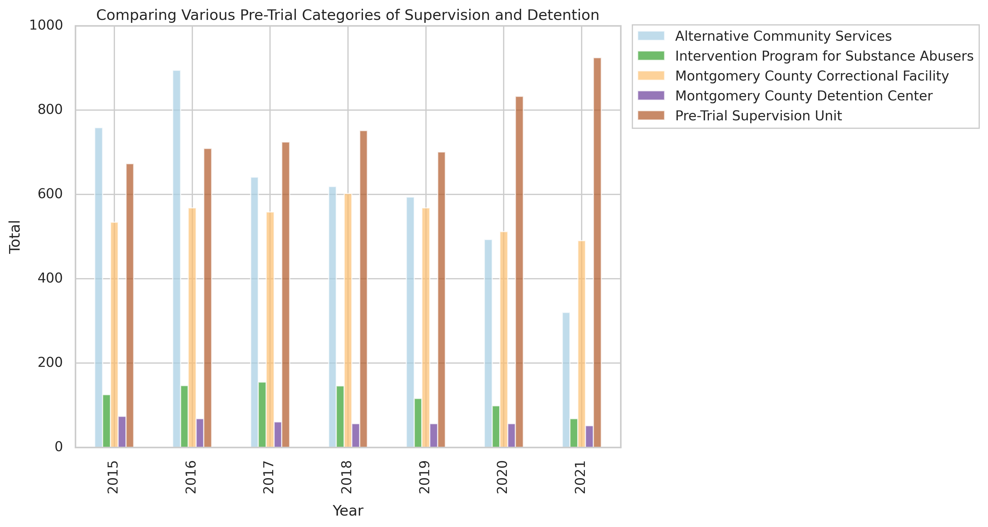
Pretrial Detention Datasets
Pre-trial Supervision has increased in the past six years among those who are not detained, which may be a result of the algorithm application.
Alternative community services and intervention programs for substance abusers have both decreased
This data raises the question:
Does the Algorithm result in mass channeling to pretrial probation, even if health and community services may be more appropriate and effective?

Slide 17
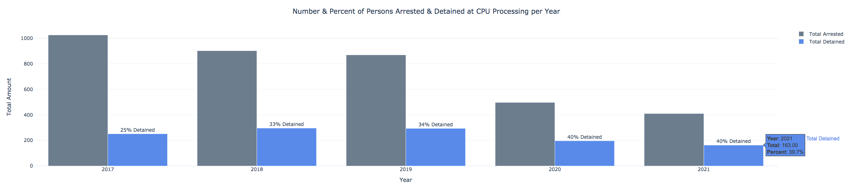
Pretrial Detention Datasets
The percentage of persons arrested who were immediately detained increased steadily from 25% in 2017 to 40% in 2020 and 2021.
So let us examine variables other than the algorithm that could explain this …
Rates of arrest for violent versus non-violent offenses, and
changes in bail amounts

Slide 18
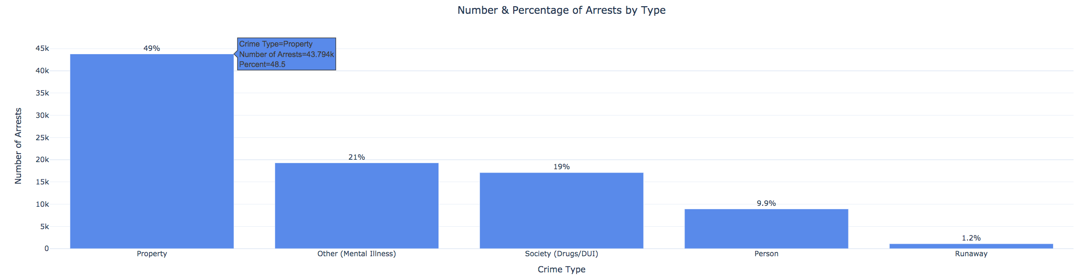
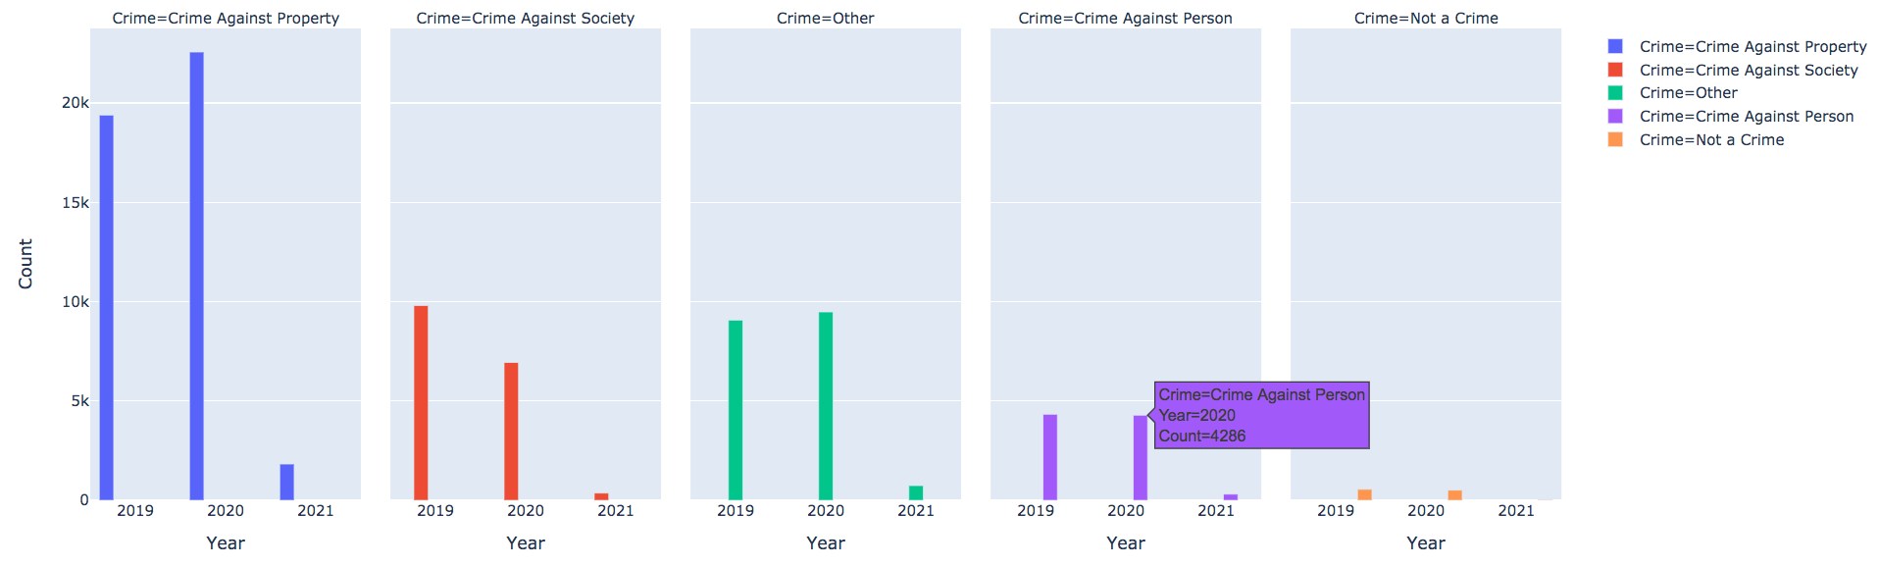
Non-Violent and Violent Crime Arrests in Pretrial Detention Datasets
Violent crimes account for only approximately 10% of all arrests, which appears consistent across the past few years (not increasing) based on available data
Thus, it does not explain the increasing detention percentage rates the CPU dataset shows.
Source: Montgomery County Crime Year to Date Dataset

Slide 19
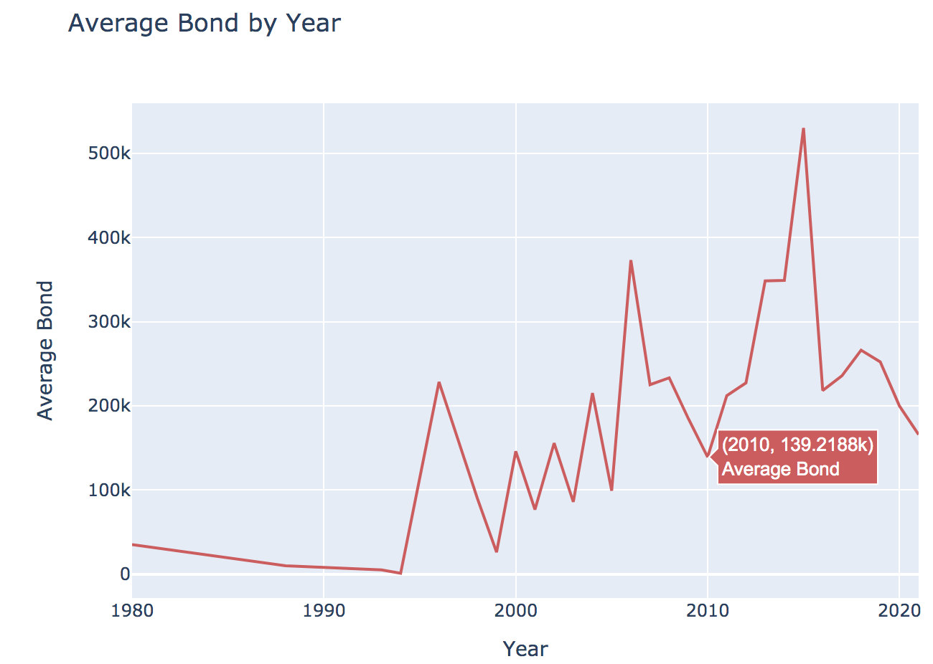
CT Pretrial Bail Dataset – Bail Amounts
Increasing trend from the mid 1990s to the mid 2010s.
Dropping steadily since 2015 – with drastic drops during COVID.
If the bail in Montgomery County followed the same national trend then because bail amounts decreased, bail amount would not explain the increased detention percentages.
CT does not currently appear to use AI in bail determinations, however they do use a Standardized Risk Assessment Instrument with similar variables as appear in the Montgomery County risk assessment tool that the Montgomery County AI algorithm was trained on.

Slide 20
Part I. Pretrial Detention Rate Datasets
Noteworthy Findings & Results
The argument that the pretrial bail algorithm in Montgomery County has resulted in, or caused a reduction in the number of people detained pretrial is not supported by the available data in Montgomery County.
As we all know, correlation does not imply causation.
In fact, the data suggests that percentage rates of persons detained pretrial have actually increased over the past few years.
While pretrial probation rates have increased, alternative community services and intervention programs for substance abusers have drastically decreased.
More comprehensive investigation, collection, and validation of bail and pretrial data are needed to determine exactly how implementation of AI algorithms have affected pretrial detention total numbers and percentage rates in Montgomery County.

Slide 21
Part II. Bias in Pretrial Bail Amounts

Slide 22
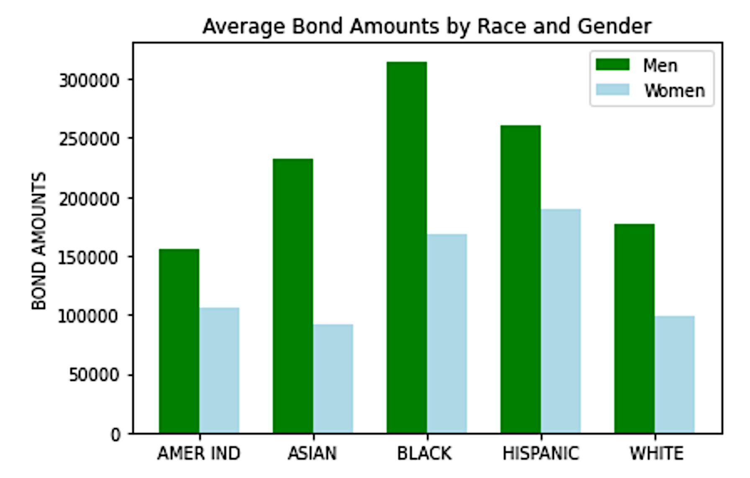
Examining Bias in CT Pretrial Detention and Bond Rates
Imagine yourself detained pretrial on bail …
How much would you, and your family, be able to afford?
The overall mean bond is $247,739.
The median bond is $100,000.
Only 11% of Bonds are under $10,000
6% of bails are less than $5,000
Only 1.5% are less than $1,000
75% of bails are over $33,500
25% are over $250,000
There are disparate average bail amounts based on Race and Gender of the defendant

Slide 23
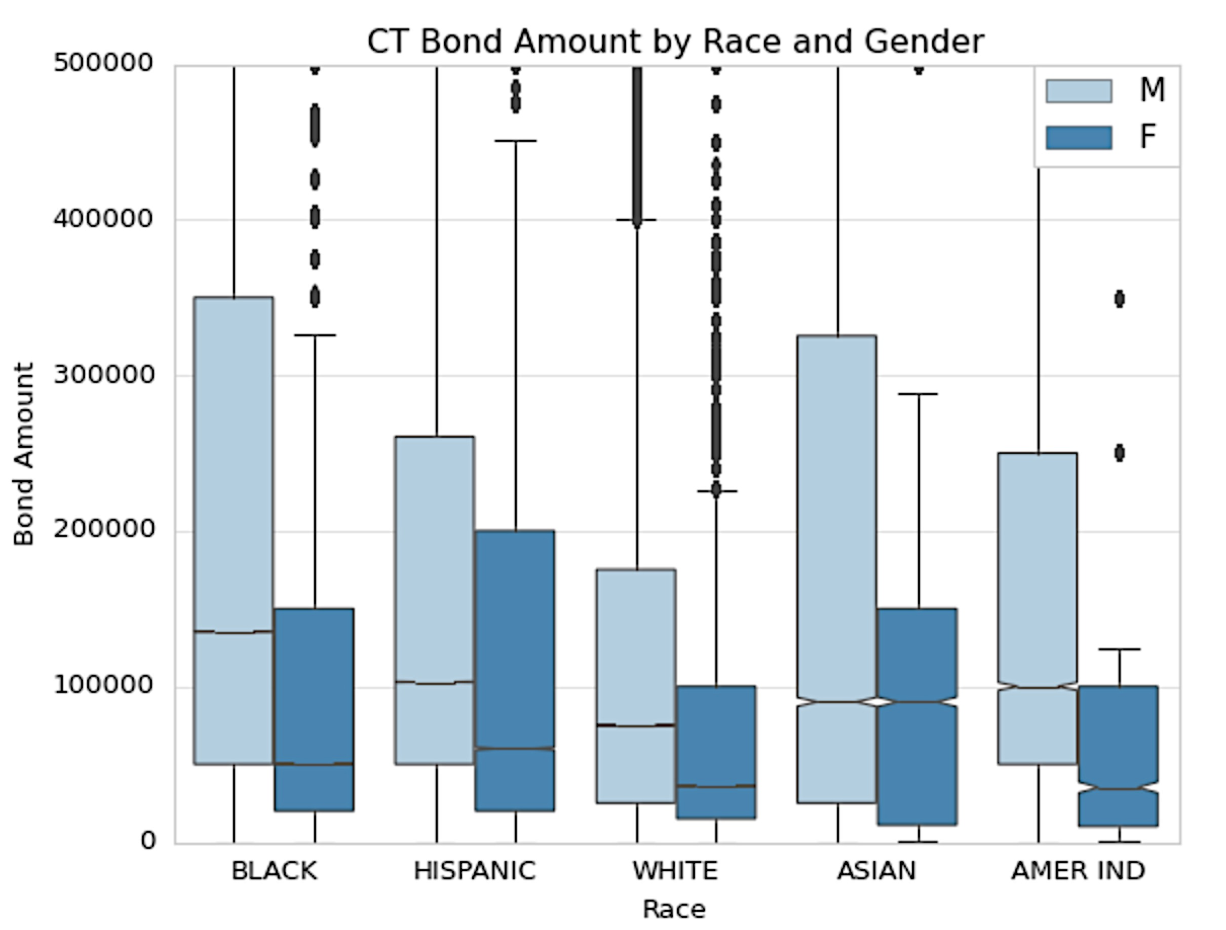
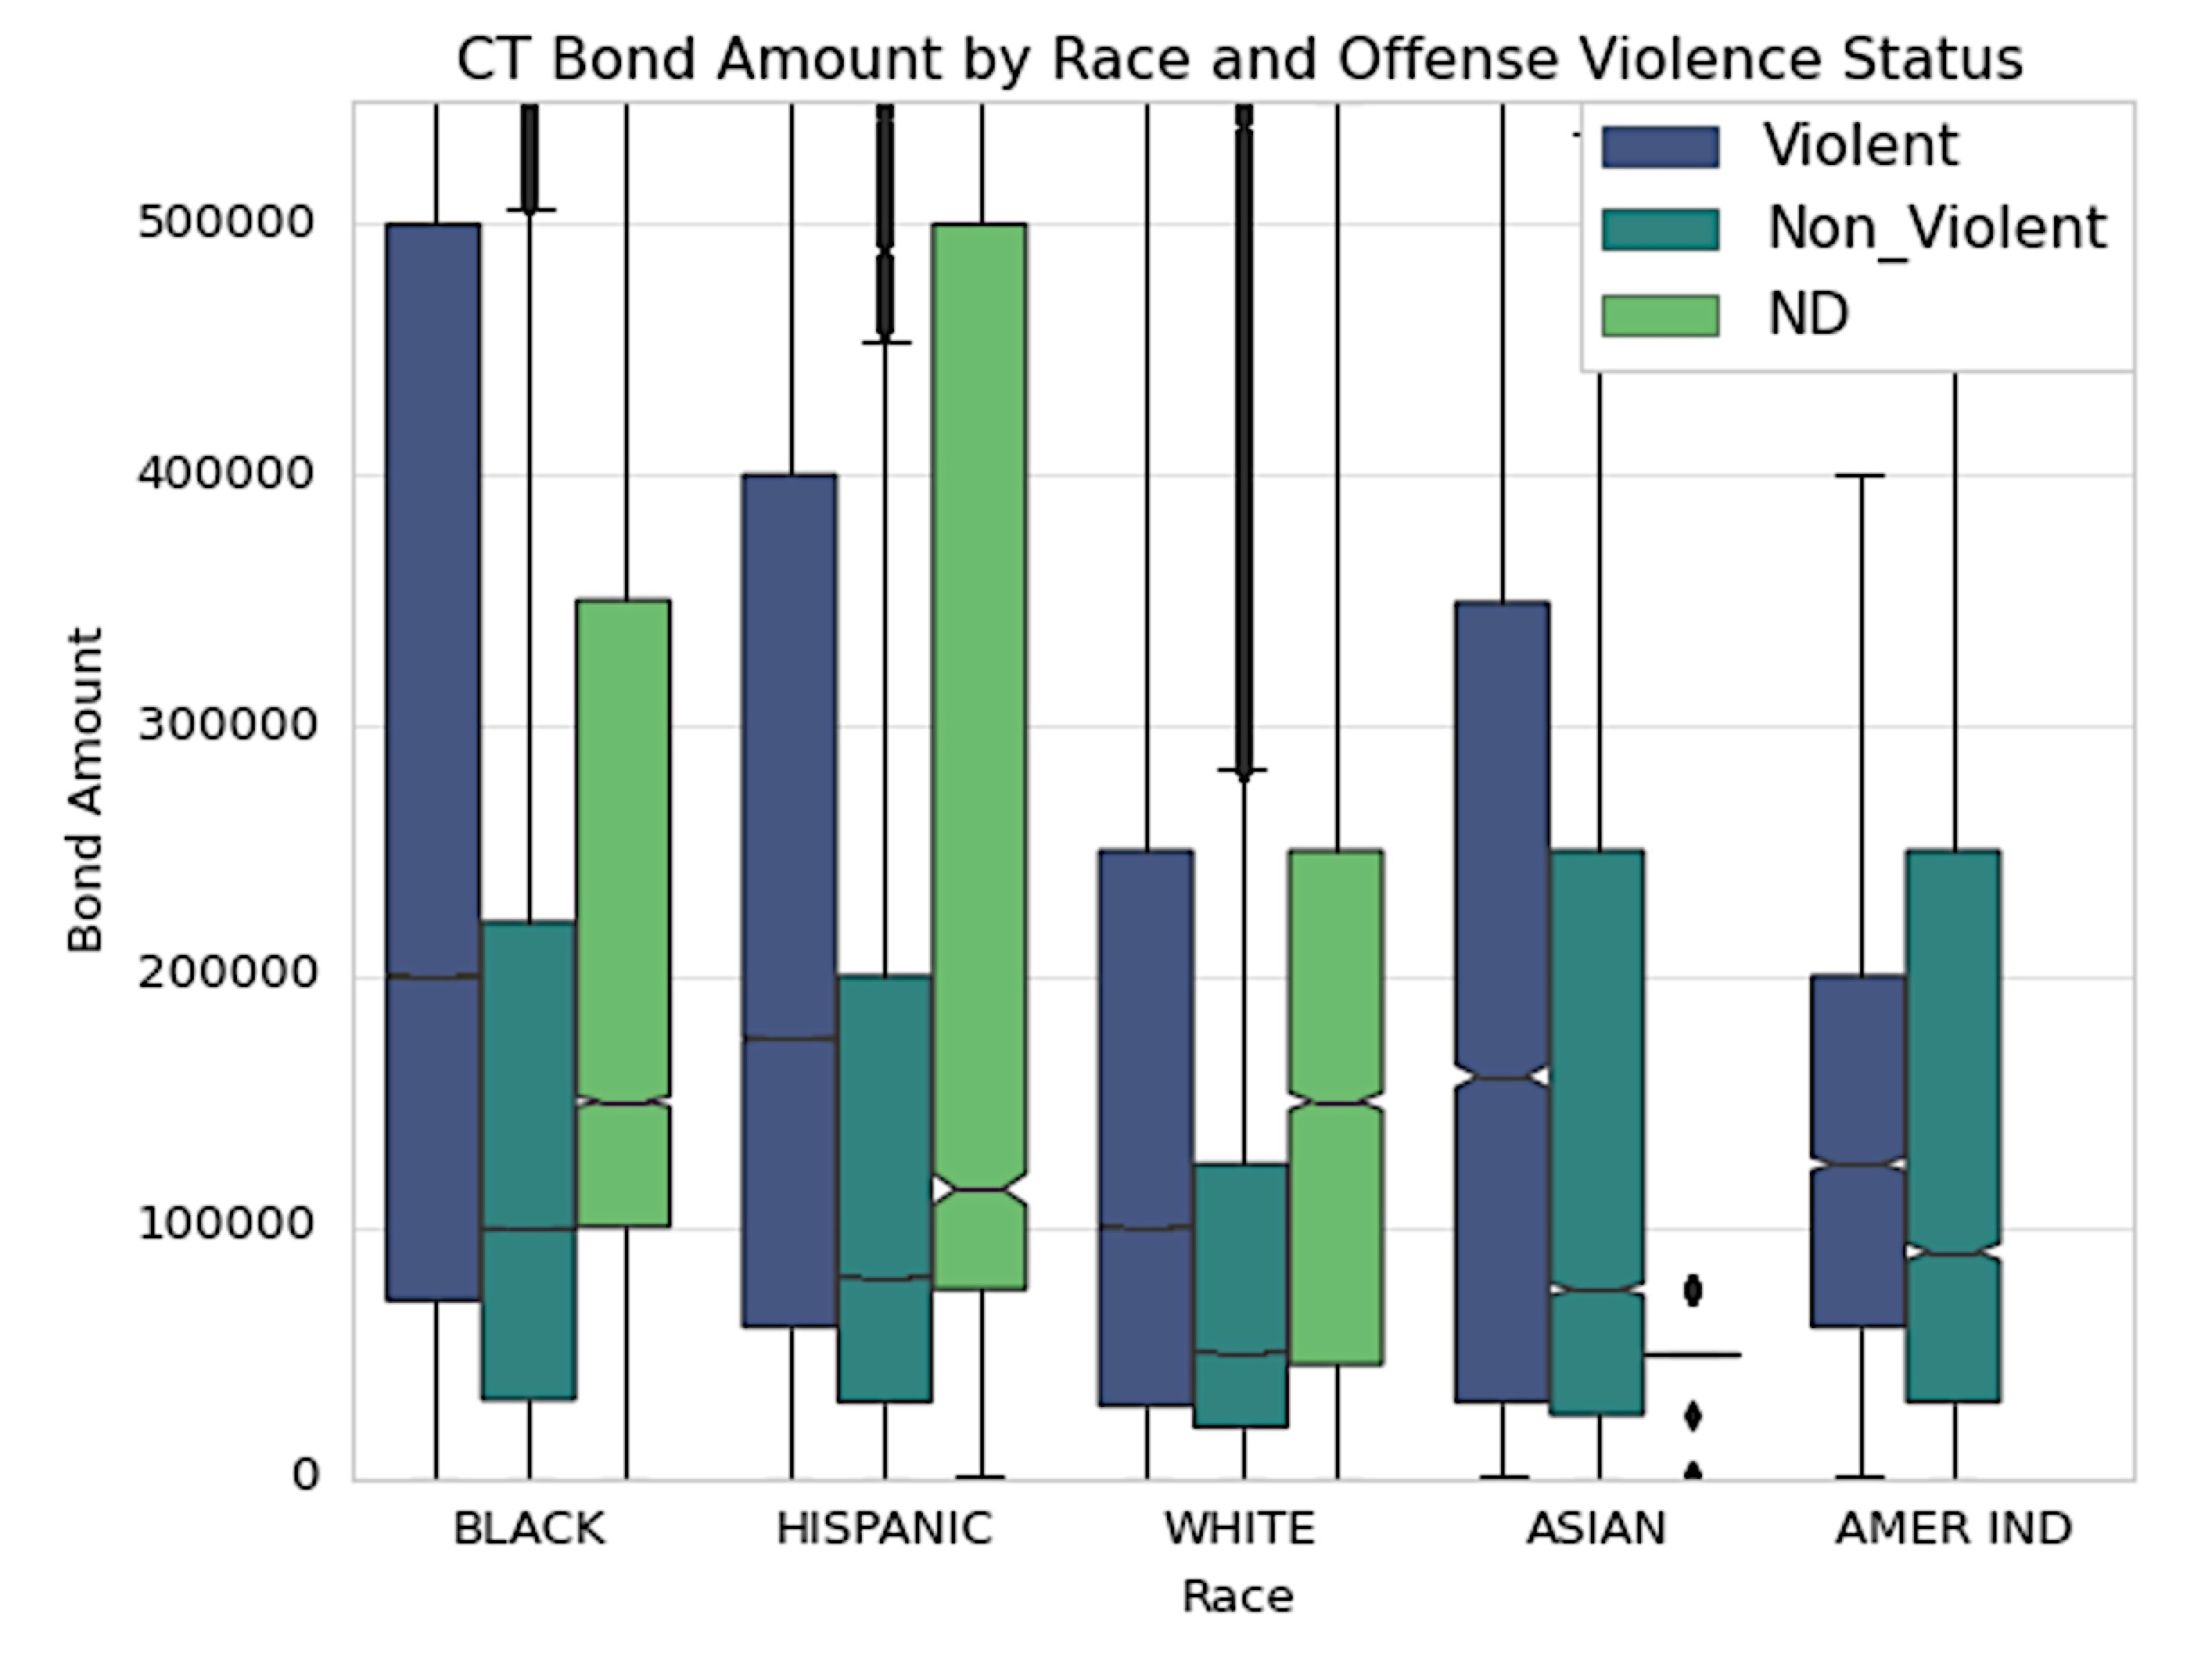
Pretrial Bail – Bail Statistics by Race and Gender
* Note: ND stands for “Not Determined”
Racial disparities in Bail Amount remain
regardless of Gender and Violent Status of alleged offense.

Slide 24
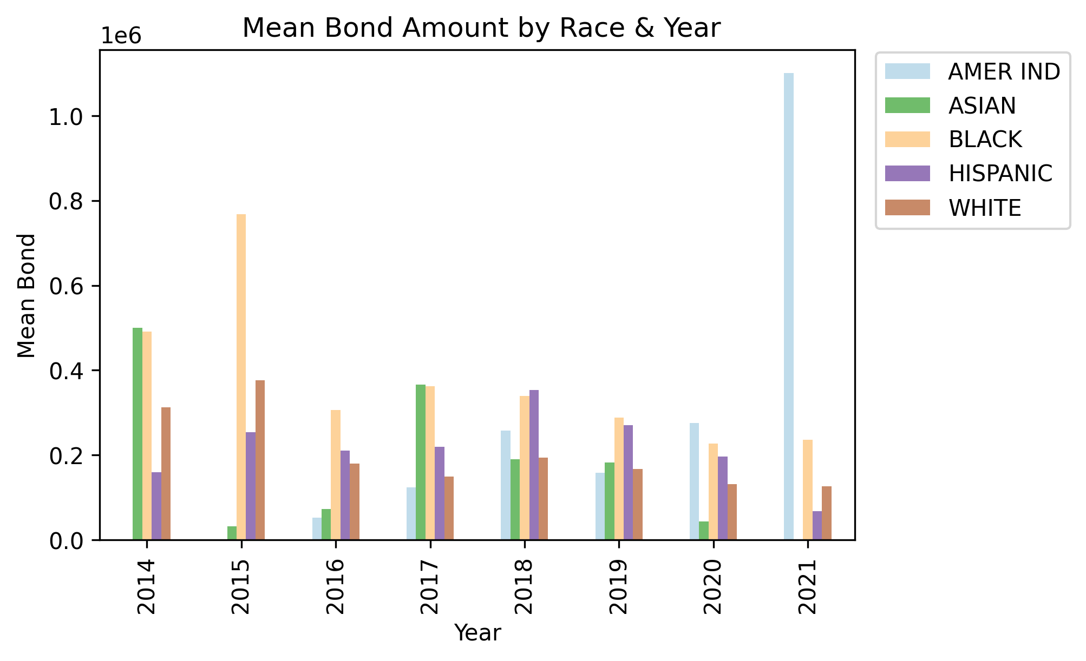
Pretrial Bail – Mean Bail by Race, 2014-2021
Racial disparities in Bail Amount have remained consistent throughout the time period of AI & Risk Assessment Tool Implementation in Pretrial Bail Determinations

Slide 25
Race | Total Number in Dataset | Percent of US Population | Percent of CT Population | Percent below the Poverty line | Percent of Defendants | Bail > $100K | Bail > $50K | Bail > $10K | Bail > $5K | Bail > $1K
Black | 2,206,677 | 12.2% | 11.1% | 21.2% | 41% | 59% | 76% | 94% | 97% | 99%
White | 1,663,676 | 60% | 74.6% | 9% | 31% | 39% | 60% | 89% | 95% | 98%
Hispanic | 1,432,744 | 18.5% | 16.9% | 17.2% | 26% | 55% | 74% | 93% | 96% | 99%
Asian | 31,994 | 5.6% | 4.7% | 9.7% | 0.6% | 49% | 68% | 88% | 94% | 99%
Native Amer. | 16,758 | 0.7% | 0.3% | 24.2% | 0.3% | 52% | 73% | 92% | 95% | 100%
TOTAL | 5,351,849
Overall Data
Race | Total Number in Dataset | Percent of US Population | Percent of CT Population | Percent below the Poverty line | Percent of Defendants | Bail > $100K | Bail > $50K | Bail > $10K | Bail > $5K | Bail > $1K
Black | 81089 | 12.2% | 11.1% | 21.2% | 55% | 82% | 92% | 96% | 97% | 98%
White | 34401 | 60% | 74.6% | 9% | 23% | 71% | 84% | 92% | 95% | 97%
Hispanic | 32403 | 18.5% | 16.9% | 17.2% | 22% | 75% | 89% | 95% | 98% | 98%
Asian | 824 | 5.6% | 4.7% | 9.7% | 0.6% | 34% | 48% | 55% | 99% | 100%
Native Amer. | 0 | 0.7% | 0.3% | 24.2% | 0% | -- | -- | -- | -- | --
TOTAL | 148,717
2015 Data
https://www.visualcapitalist.com/visualizing-u-s-population-by-race/; https://www.statista.com/statistics/1025507/connecticut-population-distribution-ethnicity-race/

Slide 26
Race | Total Number in Dataset | Percent of US Population | Percent of CT Population | Percent below the Poverty line | Percent of Defendants | Bail > $100K | Bail > $50K | Bail > $10K | Bail > $5K | Bail > $1K
Black | 312372 | 12.2% | 11.1% | 21.2% | 40% | 57% | 76% | 95% | 97% | 99%
White | 34401 | 60% | 74.6% | 9% | 32% | 38% | 61% | 89% | 95% | 99%
Hispanic | 32403 | 18.5% | 16.9% | 17.2% | 27% | 54% | 77% | 94% | 97% | 99%
Asian | 824 | 5.6% | 4.7% | 9.7% | 0.46% | 46% | 56% | 82% | 89% | 99%
Native Amer. | 0 | 0.7% | 0.3% | 24.2% | 0.29% | 48% | 69% | 87% | 96% | 99%
TOTAL | 776,326
2016 Data
Race | Total Number in Dataset | Percent of US Population | Percent of CT Population | Percent below the Poverty line | Percent of Defendants | Bail > $100K | Bail > $50K | Bail > $10K | Bail > $5K | Bail > $1K
Black | 451886 | 12.2% | 11.1% | 21.2% | 41% | 62% | 78% | 94% | 97% | 99%
White | 34401 | 60% | 74.6% | 9% | 28% | 39% | 62% | 90% | 95% | 99%
Hispanic | 32403 | 18.5% | 16.9% | 17.2% | 28% | 60% | 75% | 93% | 96% | 99%
Asian | 824 | 5.6% | 4.7% | 9.7% | 0.6% | 41% | 68% | 86% | 92% | 99%
Native Amer. | 0 | 0.7% | 0.3% | 24.2% | 0.25% | 48% | 78% | 100% | 100% | 100%
TOTAL | 1102431
2019 Data

Slide 27
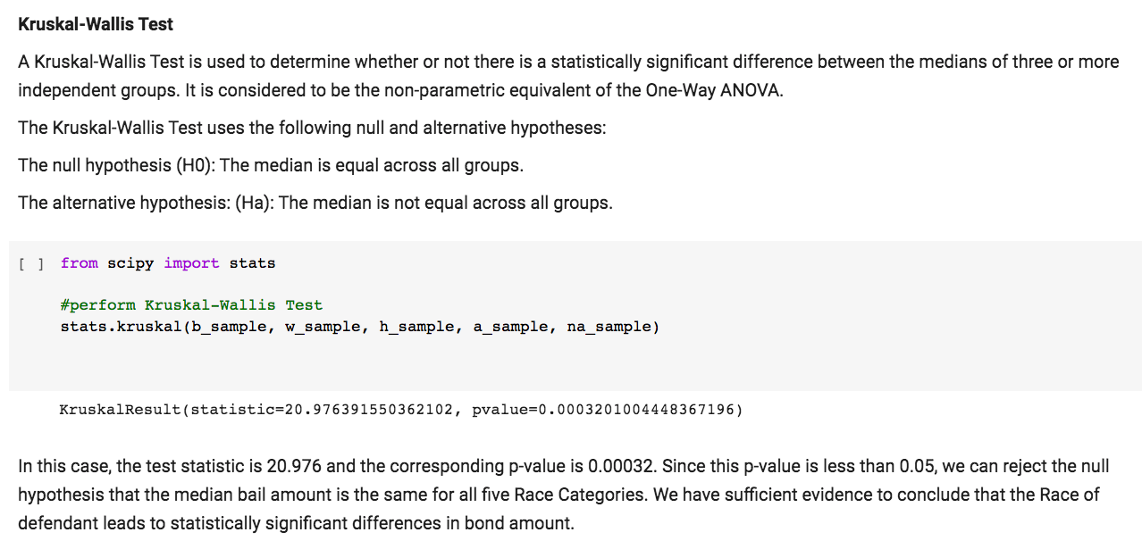
Pretrial Bail Amount & Race Statistical Test - p.value = 0.0003
The Bond Amount Variable Distribution was Not Normal
# using Random samples by race with n=5000 since dataset has 5M+ entries
The p-value is 0.0003, hence, we reject the null hypothesis.
Median Bond Amounts have statistically significant differences based on Racial Group Classification.

Slide 28
Note on the Importance of Algorithm Validation
Validation Processes investigate whether the algorithms are actually working in practice.
Montgomery County has only recently undertaken revalidating the pretrial bail algorithm.¹
This is the first validation of their risk assessment system in 10 years.¹
Data Professionals recommend comprehensive validation every year to evaluate if the assessment tools are accomplishing their intended results.²
In 2019, one Maryland County Acting Director of the Corrections Division was asked whether the county tracks metrics that could substantiate claims that the algorithm provides fair and accurate scores across different demographics.
The official’s response was very concerning:
“We do not discriminate, and I do not feel the assessment tool does at all … We don’t measure it. We just know its fair.”¹
Roberts, A. & Eckert, N. (Jan. 3, 2019). Maryland Courts Begin Using Artificial Intelligence in Bail Decisions. Maryland Reporter (via Capital News Service), para. 48.; https://marylandreporter.com/2019/01/03/maryland-courts-begin-using-artificial-intelligence-in-bail-decisions/
https://www.washingtonpost.com/opinions/marylands-move-away-from-the-devastation-of-bail/2018/01/31/dd94335e-ffb8-11e7-8acf-ad2991367d9d_story.html

Slide 29
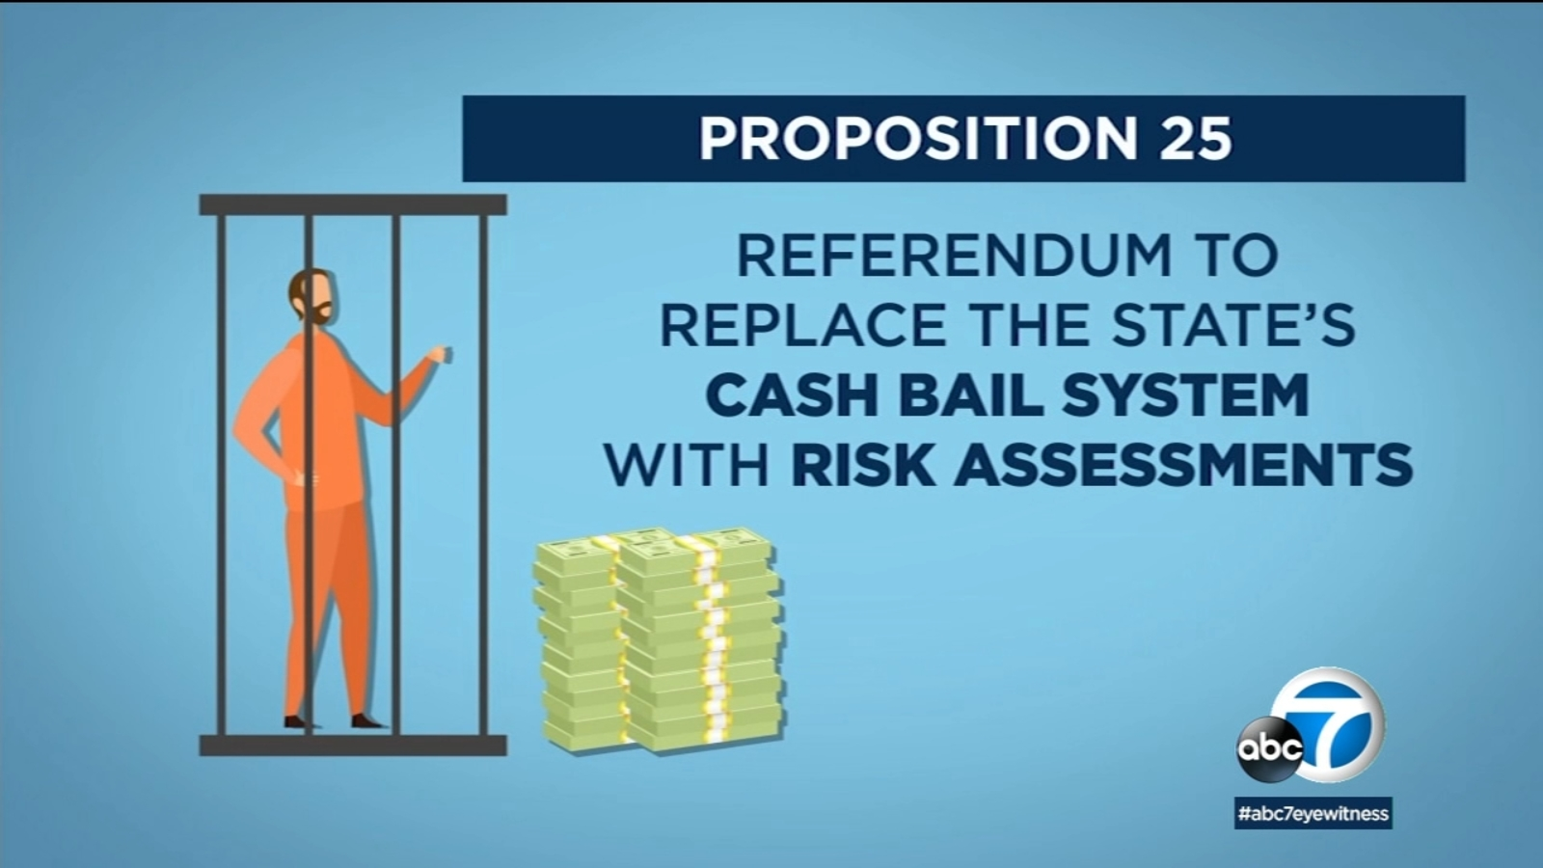
Continued Note on the Importance of Algorithm Validation
In 2020, voters in CA Rejected Proposition 25¹
Prior to the election 27 prominent scholars from MIT, Harvard, Princeton, NYU, UC Berkeley and Columbia pulled their previous support²
Their research showed that the algorithms perpetuate and increase, rather than decrease, biases currently in the system, especially racial bias.
The bias was in part due to the lack of practice of actual algorithm validation.
In New Jersey, bail algorithm validation metrics also exposed that the algorithms have not changed recent racial disparity data at all. ³
https://en.wikipedia.org/wiki/2020_California_Proposition_25
Hao, K. (Jan. 21, 2019). AI is sending people to jail – and getting it wrong. MIT Technology Review. https://www.technologyreview.com/2019/01/21/137783/algorithms-criminal-justice-ai/
https://www.boldbusiness.com/digital/robot-judges-algorithmic-bail/

Slide 30
Part II. Bias in Pretrial Bail Rate Datasets
Noteworthy Findings & Results
The data makes clear …
The use of AI Algorithms and Pretrial Risk Assessment Tools have not resulted in a reduction of bias and racial discrepancies in bail amounts.
Montgomery County provides no dataset to examine bail amounts locally.
Montgomery County has not been adequately and regularly validating their algorithm and risk assessment tools for accuracy and bias reduction.
As we all know, from the great data science adage: “junk in = junk out”
Validation is protection against both.
Montgomery County representatives working in the Criminal Justice System
must be better educated about the importance of assessment tool metrics and validation.

Slide 31
Part III. Police Internal Affairs Investigations

Slide 32
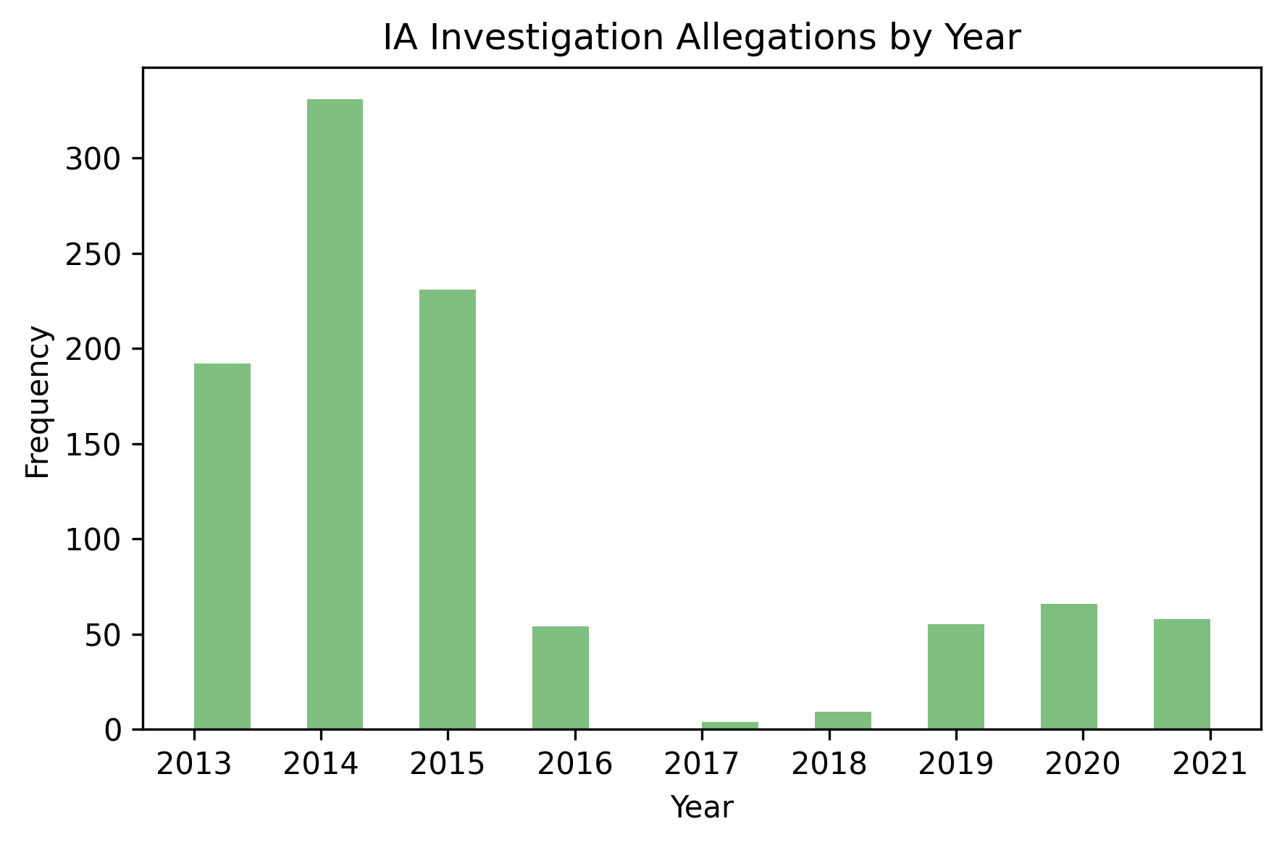
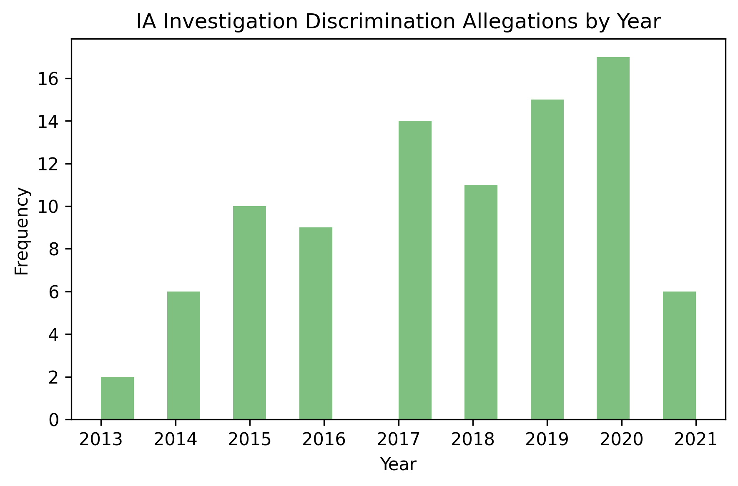
Noteworthy Findings & Results – Internal Affairs Datasets
Overall the information provided in the IA datasets is much less comprehensive than the other criminal justice system datasets.
Recorded IA complaints in general have steadily decreased since 2014
IA Discrimination and Harassment complaints have steadily increased since 2014

Slide 33
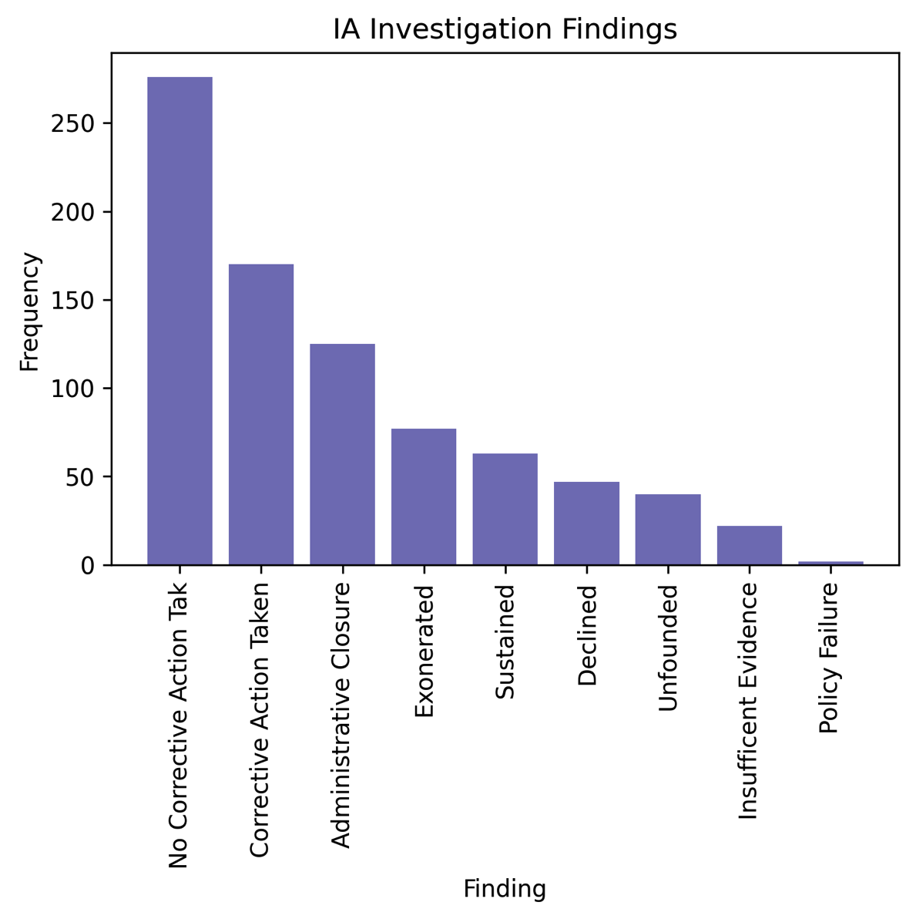
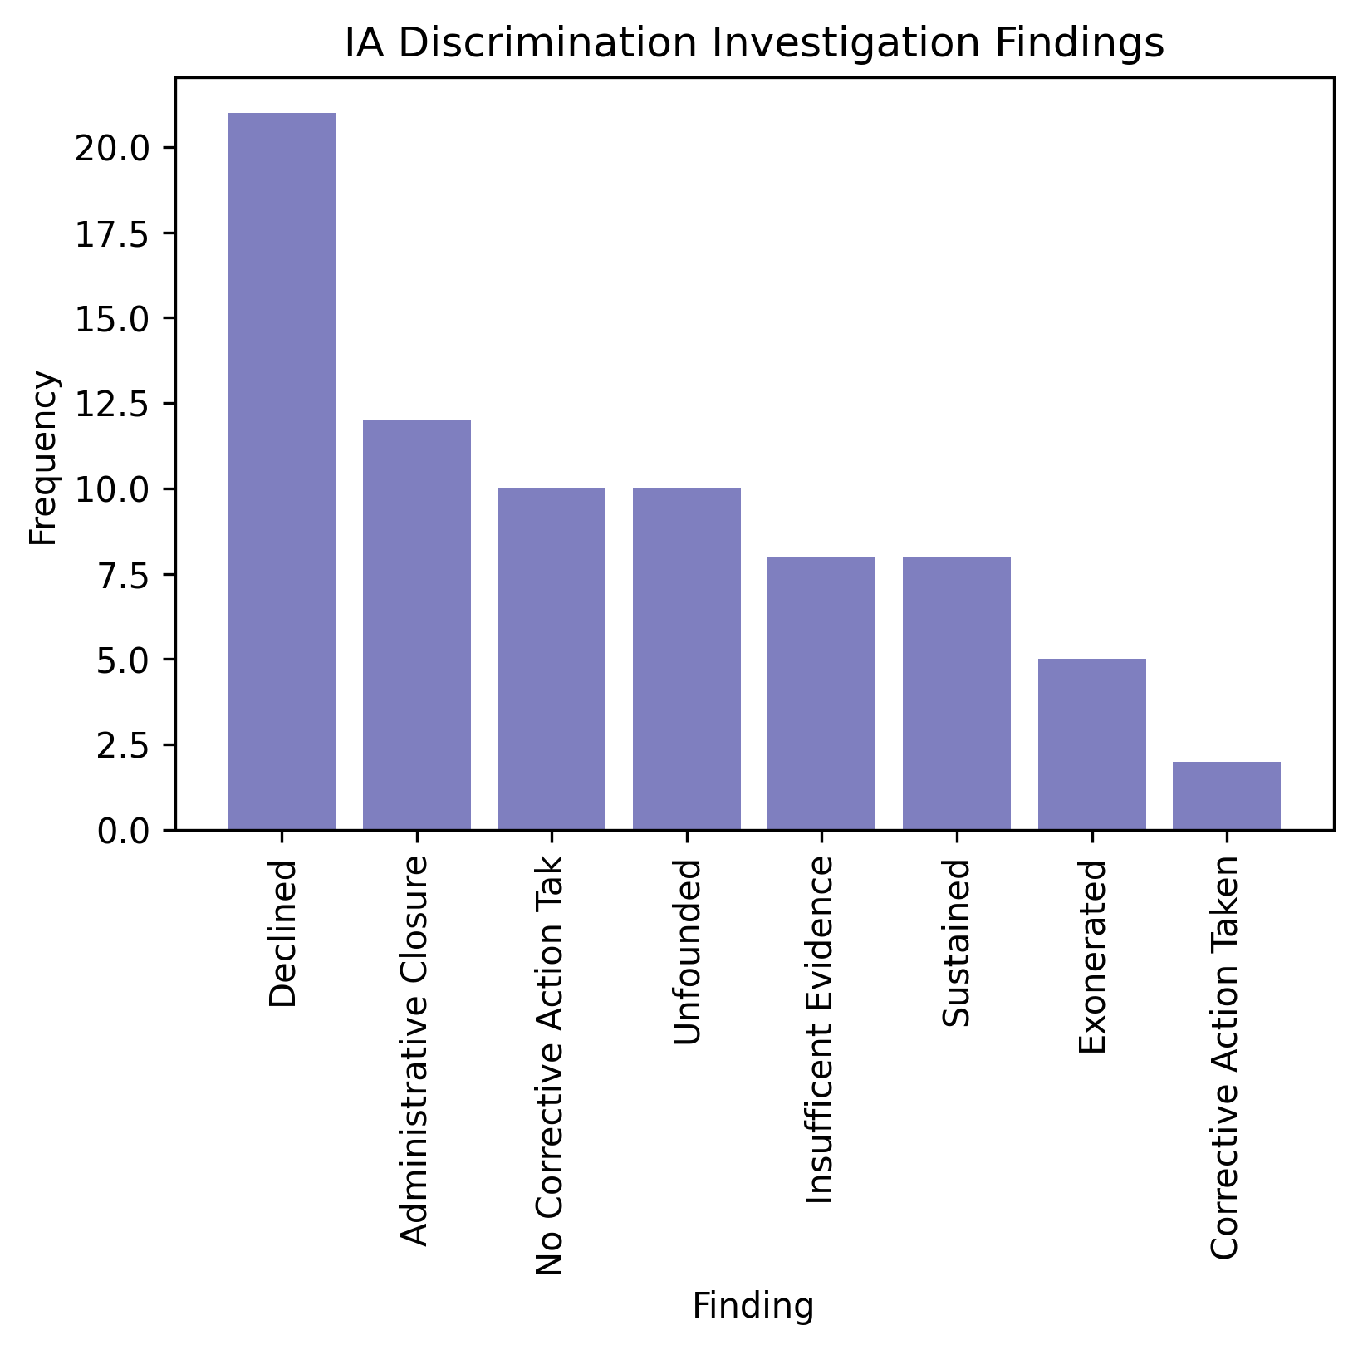
Internal Affairs Datasets – Corrective Action Rates
17%
2%
Corrective Action is taken in only 17% of all IA complaints
Corrective Action is taken in only 2% of discrimination & harassment cases

Slide 34
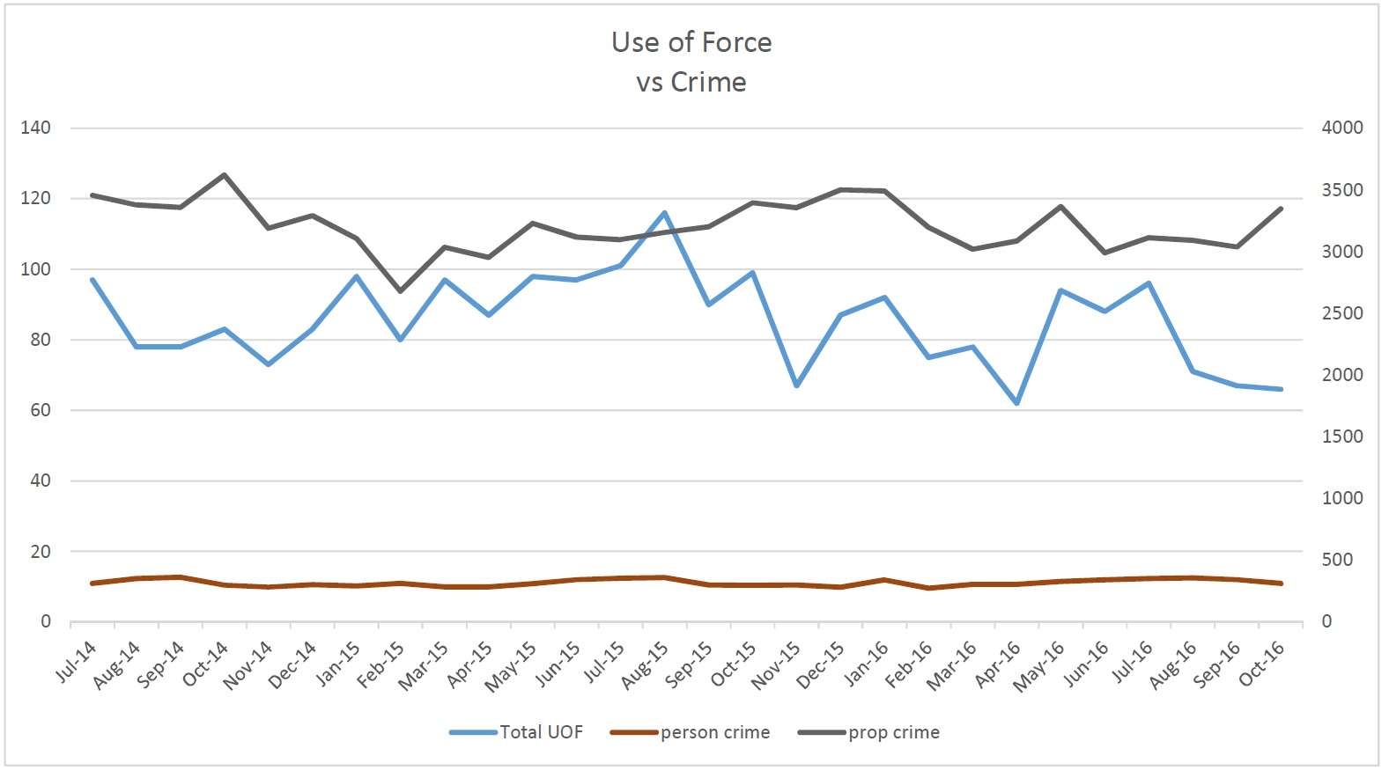
Rates of Police Use of Force Compared to Violent and Non-Violent Crimes
This DOJ data raises a question about excessive use of force by police….
From a 2017 Federal DOJ Investigation Report on Police Use of Force in Seattle, WA
Equivalent Police Use of Force Data is not available in Montgomery County for a local analysis
https://sccinsight.com/2017/04/08/understanding-the-police-monitor-report-on-use-of-force/; https://sccinsight.com/wp-content/uploads/2017/04/Assessment-Use-of-Force.pdf

Slide 35
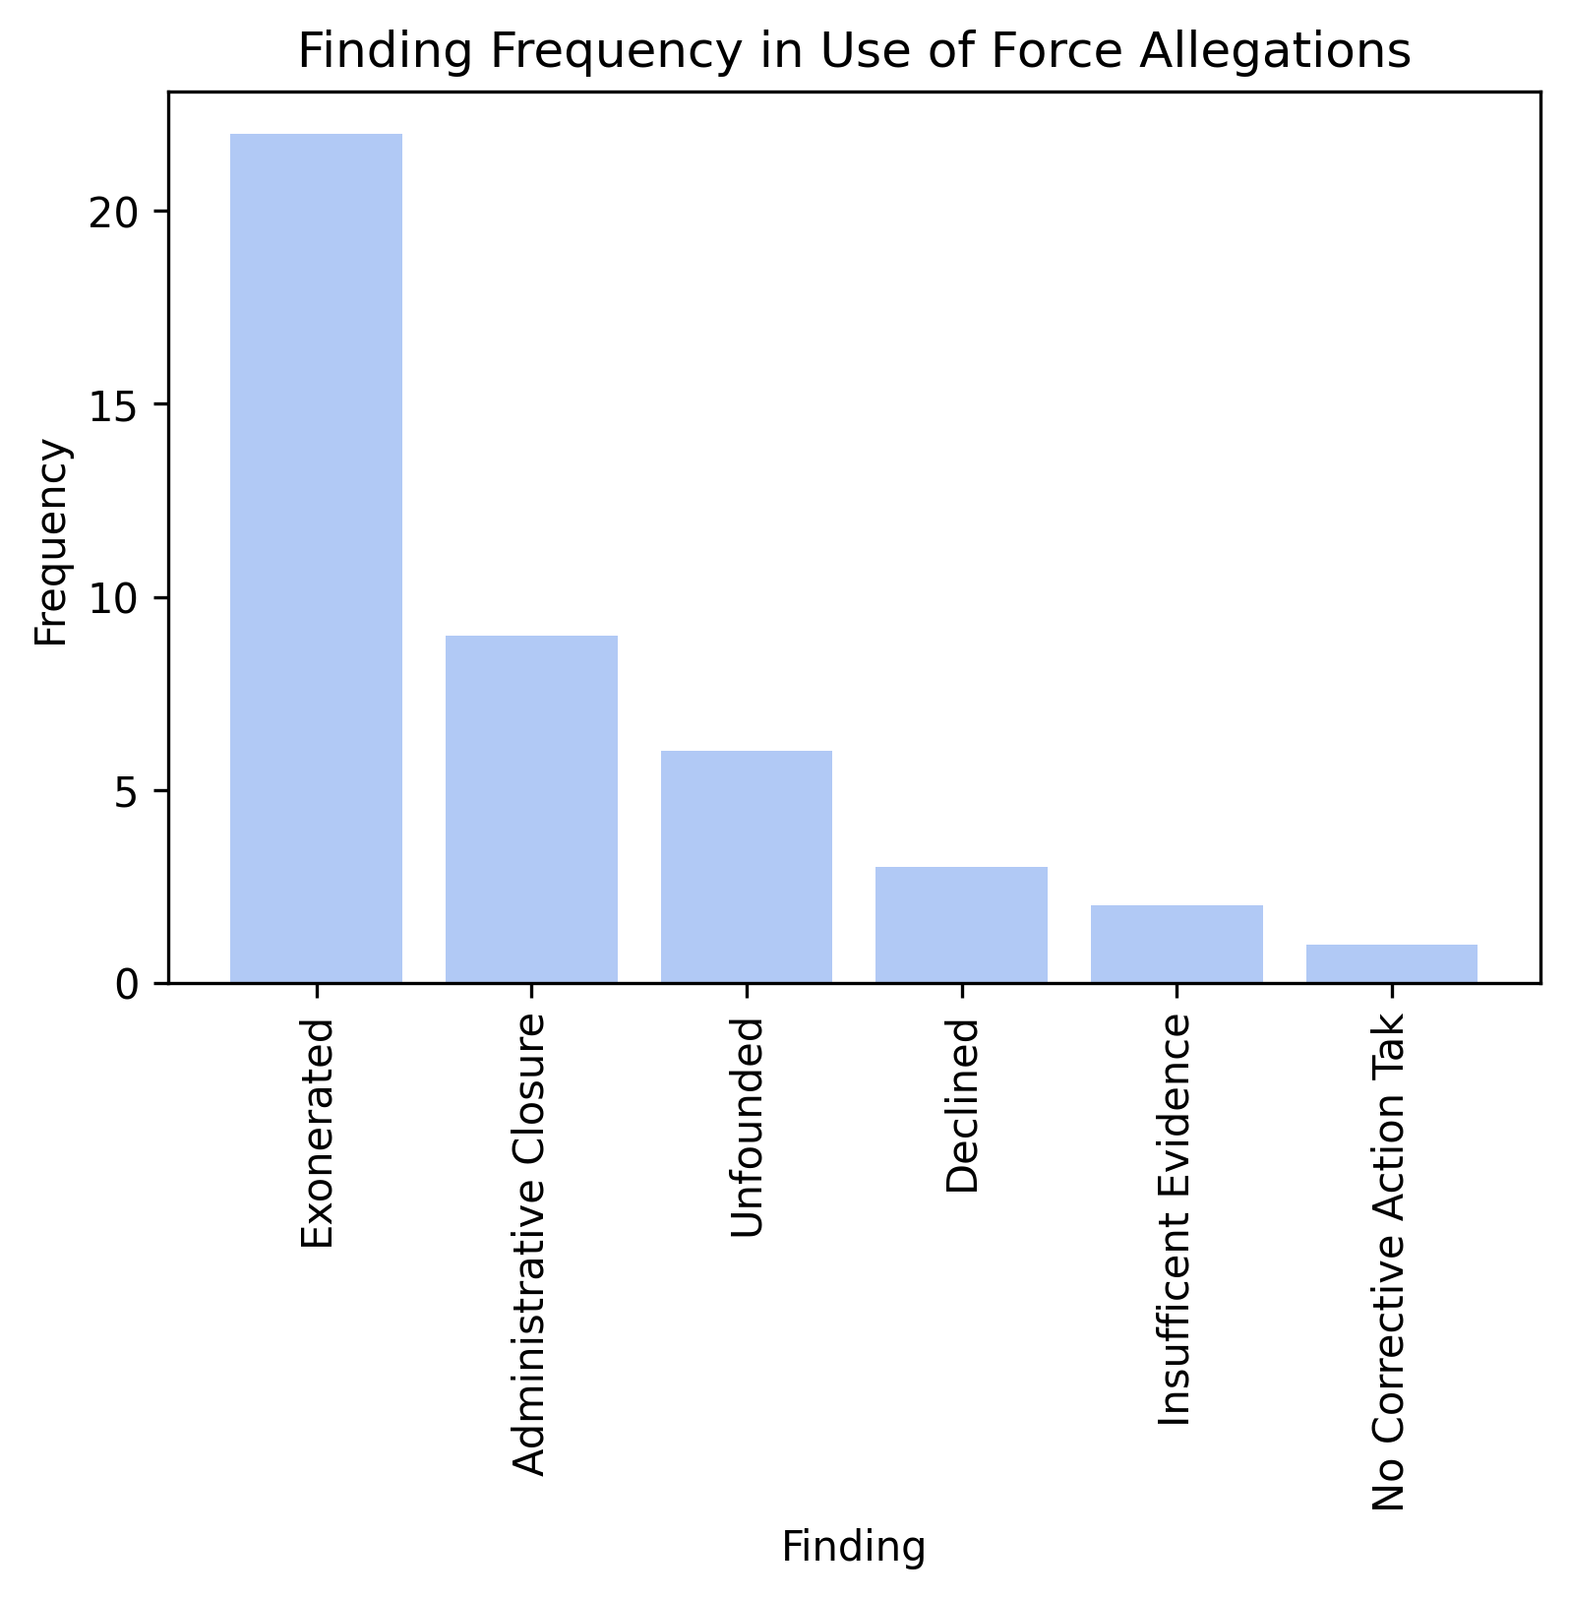
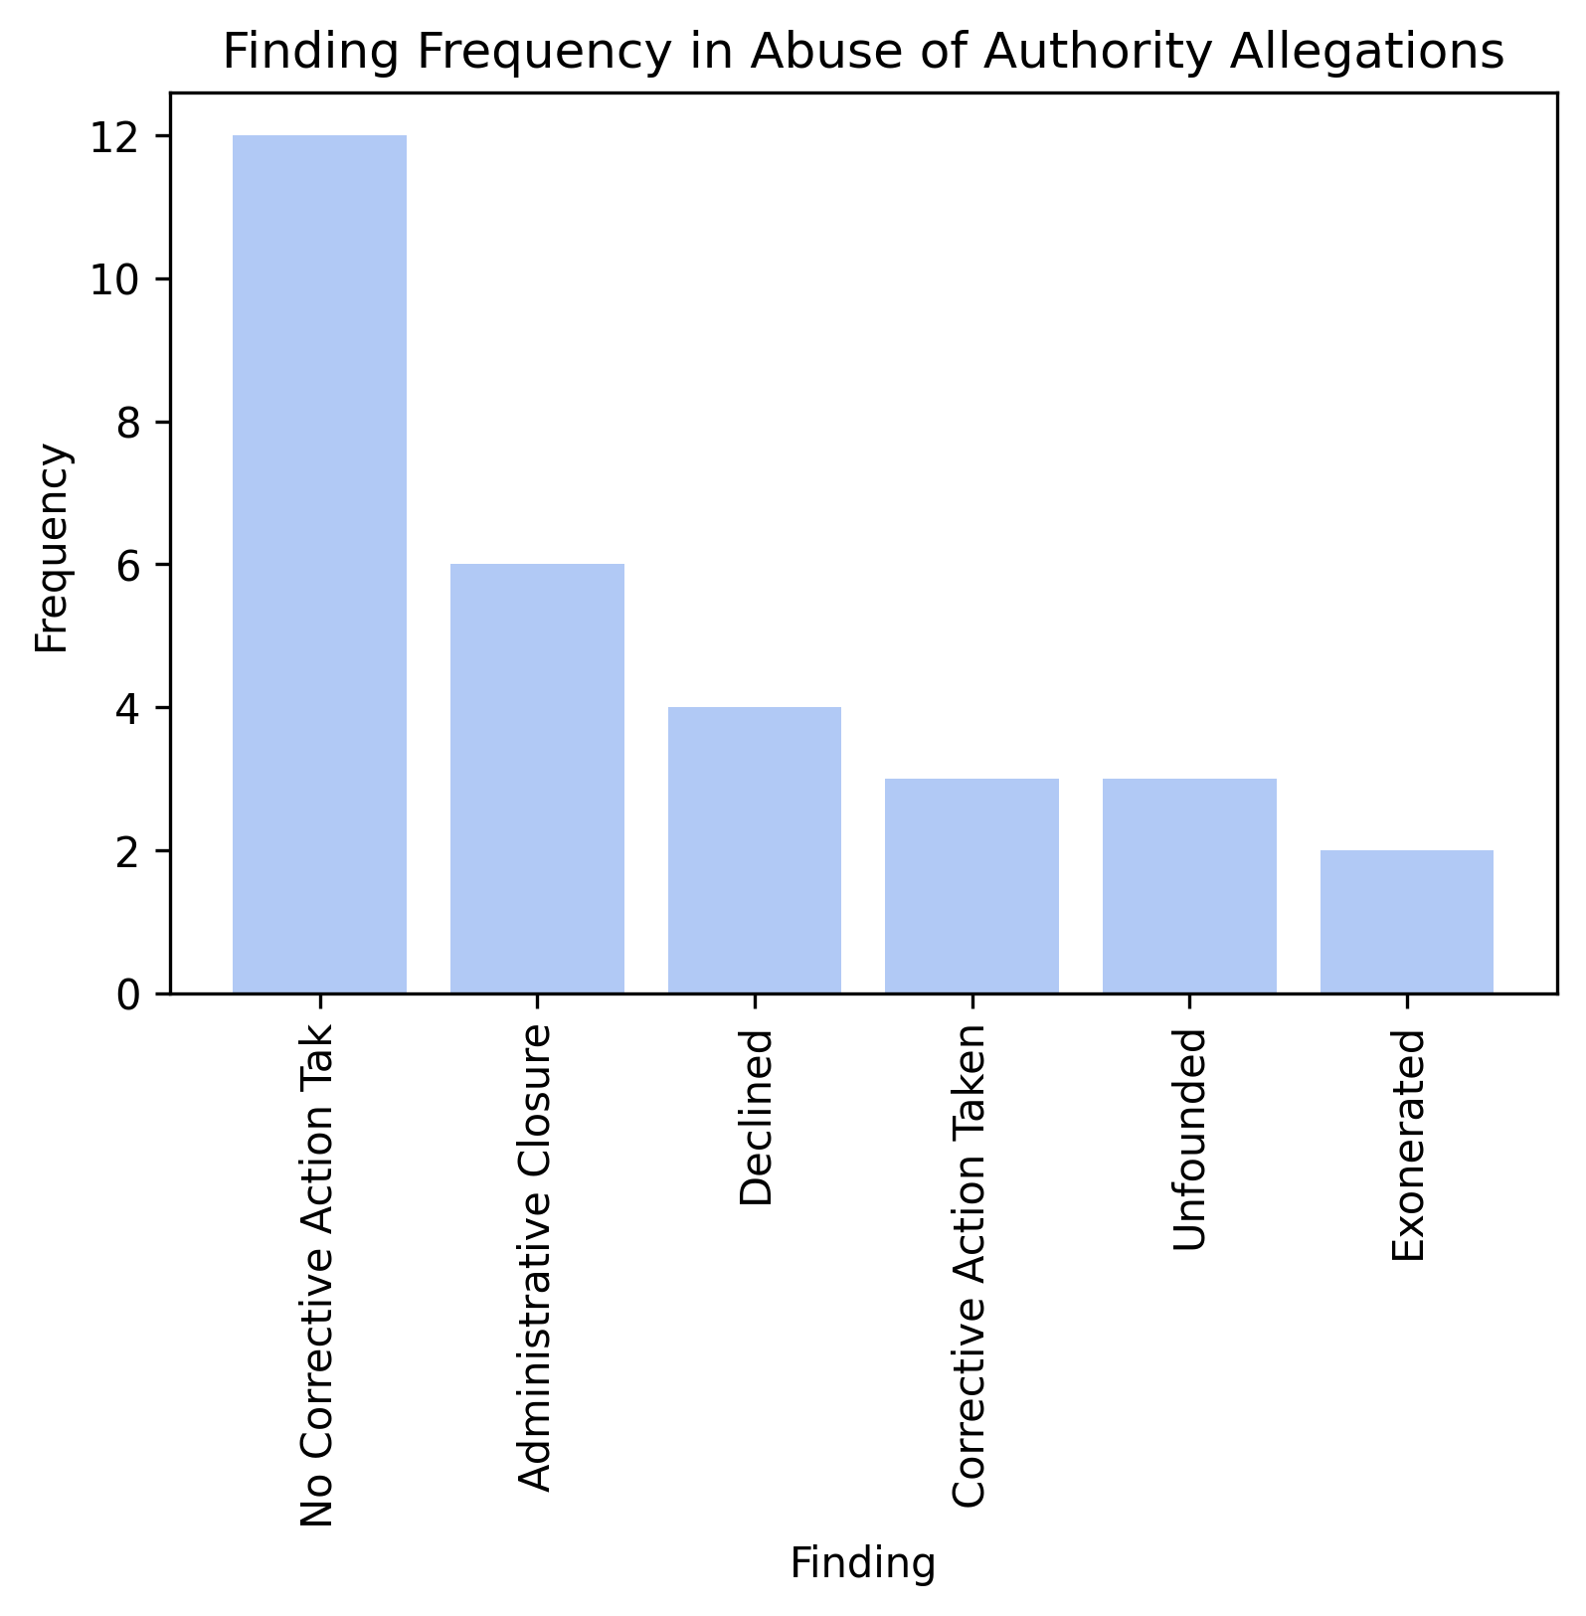
Internal Affairs Datasets – Use of Force/Abuse of Authority Corrective Action Rates
10%
Corrective Action was taken in 0 out of 43
Use of Force IA Allegations.
Corrective Action was taken in only 3 out of 30
Abuse of Authority IA Allegations.

Slide 36
Part III. Internal Affairs Datasets – Findings & Discussion on Accountability
The available data suggests that in Montgomery County:
There is a lack of accountability for police officer misconduct.
There is little to no accountability in cases of alleged police discrimination, harassment, abuse of authority, and use of force.
We have no available data on what types of corrective action were taken, when they were.
These statistics are consistent regardless of whether the complainant was internal or external to the Police Department.

Slide 37
Internal Affairs Datasets – Can AI Algorithms Reduce Police Misconduct?
AI Algorithm “risk scores” (like for bail) exist for police officer misconduct and are currently in use¹
Metropolitan Nashville Police Department, TN
Albuquerque Police Department, NM and
San Jose Police Department, CA
White House’s Police Data Initiative and University of Chicago Researchers are developing an algorithm that can foresee adverse interactions between officers and civilians²
ranging from impolite traffic stops to fatal shootings.
The system then outputs, or suggests, preventative measures to be taken.
Three large police departments are signed on to use the research:
Charlotte, NC, Los Angeles County, CA and Knoxville, TN
Criticisms
Many police union grievances call the algorithms subjective and inconsistent.
There is no equivalent grievance from the police unions regarding the similar algorithms being used in bail determinations.
In both situations, metrics analysis and validation of AI algorithms assessing human behavior, and drastically impacting human lives, is incredibly important
1. https://fivethirtyeight.com/features/we-now-have-algorithms-to-predict-police-misconduct/; 2.https://www.analyticsinsight.net/can-police-brutality-reformed-using-artificial-intelligence/

Slide 38
Overall Project Conclusions
Behavioral accountability systems should be applied equally in the Criminal Justice System, and with the least possible amount of bias, across both civilian and law enforcement populations.
According to the data, accountability systems in Montgomery County are currently unequally applied and biased
– with and without the application of current AI algorithms.
When algorithms are used, especially in historically unequal and biased systems, regular (and preferably legislatively required) thorough evaluation and validation of algorithm metrics is crucial.
According to the research, the algorithms used in Montgomery County
are not currently being adequately assessed and validated.

Slide 39
Recommendations For Montgomery County
Datasets:
Provide transparency by creating a bail dataset similar to the CT dataset, including demographic information, so biases in practices and results can be accurately measured.
Provide information in the Correctional Facility Average Daily Population dataset of the number of persons detained pretrial versus post-conviction, as well as demographic information.
Provide more comprehensive information regarding Internal Affairs Investigations, including more specific information regarding what kind of corrective action was taken and demographic information of complainant and accused. Also, evaluate the IA dataset for overlapping entries.
Record detailed data regarding implementation of Maryland’s 2021 police reform acts in Montgomery County and make it available to the public – it is an opportunity for MD and Montgomery County to continue to be a national leader on this topic.
Create a dataset with incidences of police use of force.
Policy and Practice:
Sponsor legislation that all AI software must be validated at least annually and assessed for bias trends and outcome accuracy. Avoid the culture of: “We don’t measure it. We just know it’s fair” (for all algorithms utilized by the County).
Research applications of AI software to assess police behaviors and communication to identify patterns of misconduct.
Initiate Education of Montgomery County Criminal Justice Staff on the importance of risk assessment tool validation reviews.

Slide 40
Recommendations For Data Scientists
Data Scientists can actively educate ourselves about the actual human consequences of our programming. It is easy to sit in a room and code without having a sense of the actual human impact of our coding (similar to the act of writing codifying legislation) – we must be intentional about it.
Data Scientists can intentionally counteract patterns of dehumanization and systemic inequality that may be present in the history, structure, and/or substance of training model data.
Data Scientists can incorporate ethics into actual practices despite pressures to maximize efficiency.
Data Scientists can incorporate user-friendly monitoring, assessment and validation tools for our algorithms to increase the likelihood of metrics reviews and re-assessments in practical day-to-day applications by governmental and private industry clients.

Slide 41
Acknowledgements
My sincerest thanks and acknowledgment goes out to the people who have supported me throughout the Data Science Certificate Course at Montgomery College:
For making the program transformative and rewarding:
Professor Saidi
Professor Mohamed
Professor Iapalucci
For helping each other learn about data science:
All of the other Data Science students
For providing open-source data resources and continually supporting this program:
Montgomery County Government Staff
dataMontgomery Staff
Victoria Lewis

Slide 42
“Truth never damages a cause that is just.”
― Mahatma Gandhi
“It is better to risk saving a guilty person than to condemn an innocent one.”
― Voltaire
“Where justice is denied, where poverty is enforced, where ignorance prevails, and where any one class is made to feel that society is an organized conspiracy to oppress, rob and degrade them, neither persons nor property will be safe.”
― Frederick Douglass
“You have to teach your algorithm what it can do and what it cannot do because, otherwise, there is a risk that the algorithms will learn the tricks of the old cartels.”
― Margrethe Vestager

